Slide 1
Integration
Twitter: @Owen134866
www.mathsfreeresourcelibrary.com

Slide 2
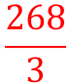
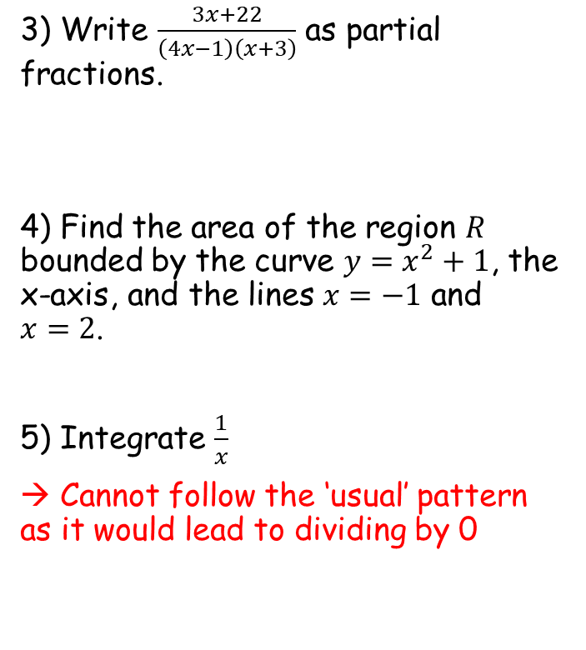
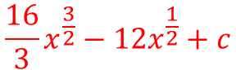
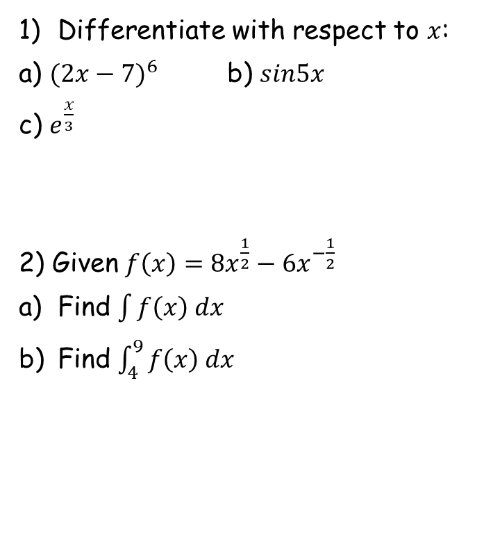
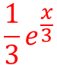
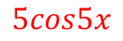

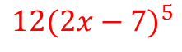
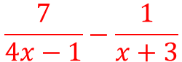
Prior Knowledge Check
Differentiate with respect to $x$:
a) ${(2x−7)}^{6}$ b) $sin5x$
c) $e^{\frac{x}{3}}$
2) Given $f\left(x\right)={8x}^{\frac{1}{2}}−{6x}^{−\frac{1}{2}}$
Find $\int{f\left(x\right) dx}$
Find $\int_{4}^{9}{f\left(x\right) dx}$
3) Write $\frac{3x+22}{\left(4x−1\right)\left(x+3\right)}$ as partial fractions.
4) Find the area of the region $R$ bounded by the curve $y=x^{2}+1$, the x-axis, and the lines $x=−1$ and $x=2$.
5) Integrate $\frac{1}{x}$
→ Cannot follow the ‘usual’ pattern as it would lead to dividing by 0
$$12{(2x−7)}^{5}$$
$$5cos5x$$
$$\frac{7}{4x−1}−\frac{1}{x+3}$$
$$\frac{1}{3}e^{\frac{x}{3}}$$
$$\frac{16}{3}x^{\frac{3}{2}}−12x^{\frac{1}{2}}+c$$
$6$ units squared
$$\frac{268}{3}$$

Slide 3
Teachings for
Exercise 11A

Slide 4
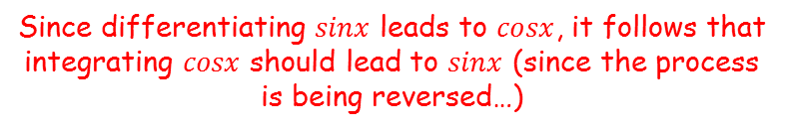
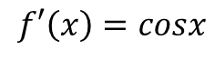
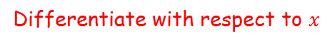
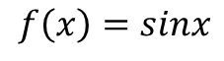
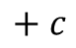
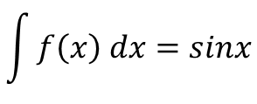
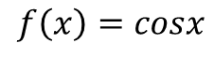
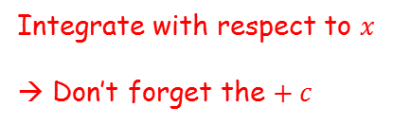
Integration
You need to be able to integrate using standard functions
Standard functions are those which you have already seen, but from the perspective of differentiation.
$$f\left(x\right)=sinx$$
Differentiate with respect to $x$
$$f′\left(x\right)=cosx$$
Since differentiating $sinx$ leads to $cosx$, it follows that integrating $cosx$ should lead to $sinx$ (since the process is being reversed…)
$$f\left(x\right)=cosx$$
Integrate with respect to $x$
→ Don’t forget the $+ c$
$$\int{f\left(x\right) dx}=sinx$$
$$+ c$$
11A

Slide 5
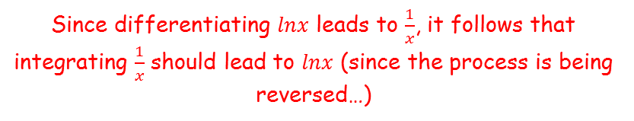
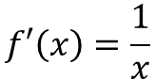
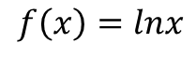
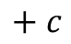
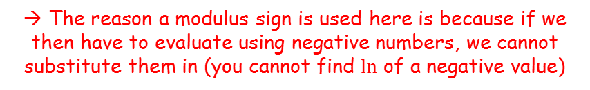
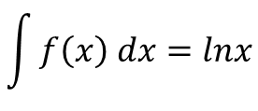
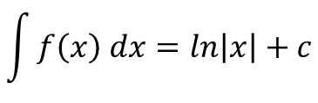
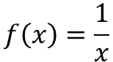
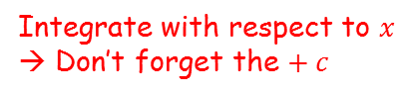
Integration
You need to be able to integrate using standard functions
Standard functions are those which you have already seen, but from the perspective of differentiation.
$$f\left(x\right)=lnx$$
Differentiate with respect to $x$
$$f′\left(x\right)=\frac{1}{x}$$
Since differentiating $lnx$ leads to $\frac{1}{x}$, it follows that integrating $\frac{1}{x}$ should lead to $lnx$ (since the process is being reversed…)
$$f\left(x\right)=\frac{1}{x}$$
Integrate with respect to $x$
→ Don’t forget the $+ c$
$$\int{f\left(x\right) dx}=lnx$$
$$+ c$$
In this case, a modulus is usually used
$$\int{f\left(x\right) dx}=ln\left|x\right|+c$$
→ The reason a modulus sign is used here is because if we then have to evaluate using negative numbers, we cannot substitute them in (you cannot find $ln$ of a negative value)
11A

Slide 6
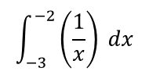
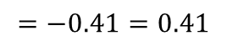
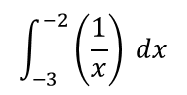
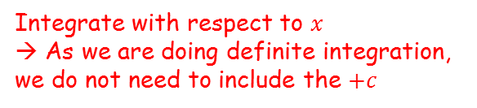
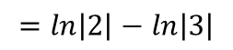
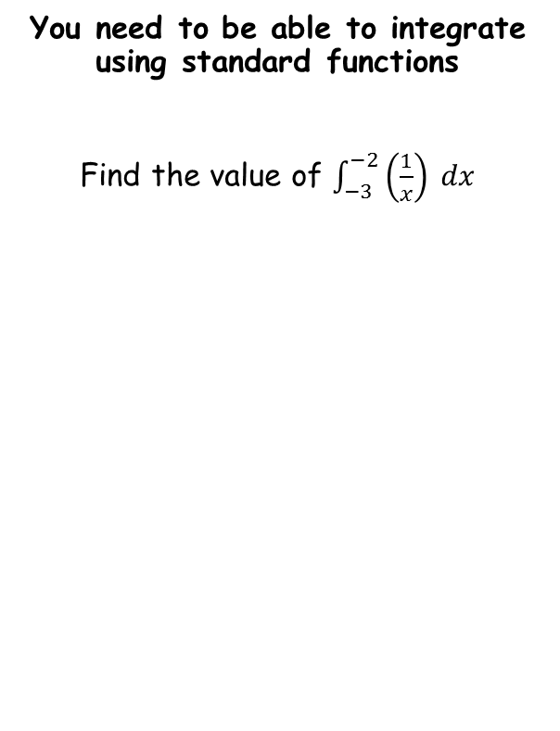
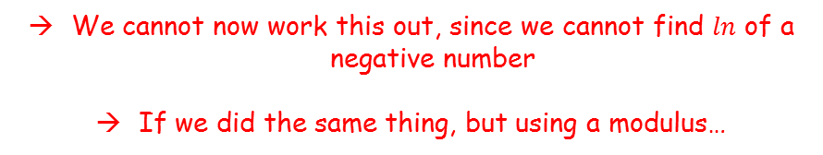

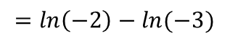
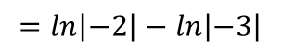
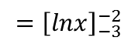
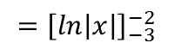
Integration
$$\int_{−3}^{−2}{\left(\frac{1}{x}\right) dx}$$
Integrate with respect to $x$
→ As we are doing definite integration, we do not need to include the $+c$
You need to be able to integrate using standard functions
Find the value of $\int_{−3}^{−2}{\left(\frac{1}{x}\right) dx}$
$$={\left[lnx\right]}_{−3}^{−2}$$
Sub in values
$$=\ln\left(−2\right)−ln⁡(−3)$$
We cannot now work this out, since we cannot find $ln$ of a negative number
If we did the same thing, but using a modulus…
$$\int_{−3}^{−2}{\left(\frac{1}{x}\right) dx}$$
Integrate with respect to $x$
→ As we are doing definite integration, we do not need to include the $+c$
$$={\left[ln\left|x\right|\right]}_{−3}^{−2}$$
Sub in values
$$=\ln\left|−2\right|−ln⁡\left|−3\right|$$
The modulus means we can use the positive values
$$=\ln\left|2\right|−ln⁡\left|3\right|$$
Calculate, and remember the answer should be positive
$$=−0.41=0.41$$
11A

Slide 7
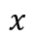
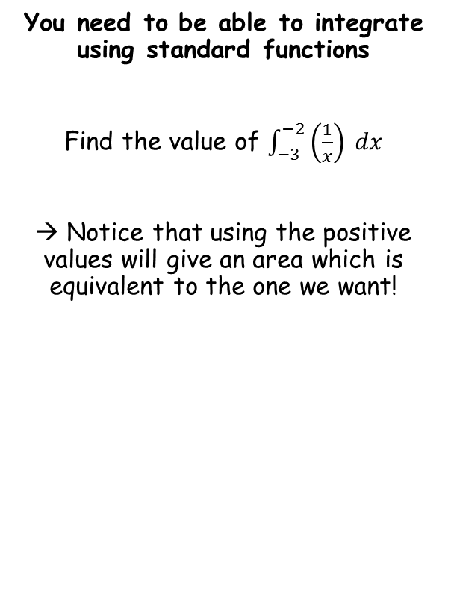
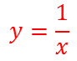
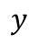
Integration
$$y$$
$$y=\frac{1}{x}$$
You need to be able to integrate using standard functions
Find the value of $\int_{−3}^{−2}{\left(\frac{1}{x}\right) dx}$
→ Notice that using the positive values will give an area which is equivalent to the one we want!
-3
-2
2
3
$$x$$
11A

Slide 8
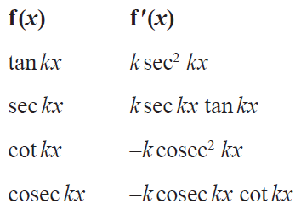

Integration
You need to be able to integrate using standard functions
You are not given the standard relationships for integration in the formula booklet, but you can use the rules from the differentiation parts to help!
So you could use this row to recall that the integral of $\sec^{2}x$ is $tanx$
11A

Slide 9
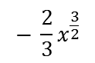
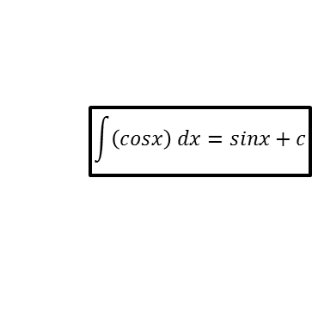
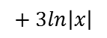
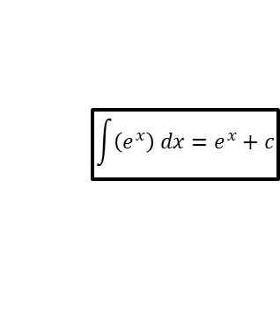
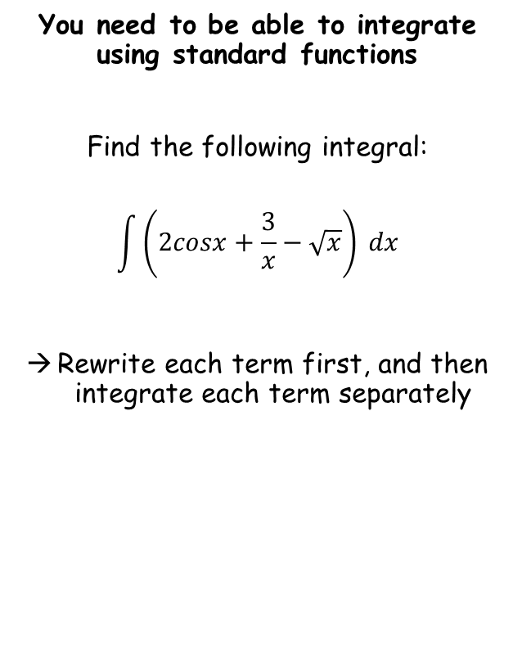
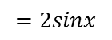

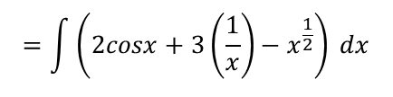
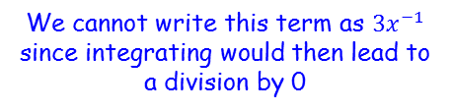
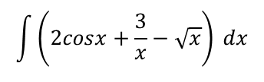


Integration
$$\int{\left(sinx\right) dx}=−cosx+c$$
$$\int{\left(cosx\right) dx}=sinx+c$$
$$\int{\left(e^{x}\right) dx}=e^{x}+c$$
$$\int{\left(\frac{1}{x}\right) dx}=ln\left|x\right|+c$$
We cannot write this term as ${3x}^{−1}$ since integrating would then lead to a division by 0
$$\int{\left(2cosx+\frac{3}{x}−\sqrt{x}\right) dx}$$
You need to be able to integrate using standard functions
Find the following integral:
$$\int{\left(2cosx+\frac{3}{x}−\sqrt{x}\right) dx}$$
Rewrite each term first, and then integrate each term separately
Rewrite each term for integration
$$=\int{\left(2cosx+3\left(\frac{1}{x}\right)−x^{\frac{1}{2}}\right) dx}$$
Integrate each term separately using rules we know
$$=2sinx$$
$$+ 3ln\left|x\right|$$
$$− \frac{2}{3}x^{\frac{3}{2}}$$
$$+ c$$
11A

Slide 10







Integration
$$\int{\left(sinx\right) dx}=−cosx+c$$
$$\int{\left(cosx\right) dx}=sinx+c$$
$$\int{\left(e^{x}\right) dx}=e^{x}+c$$
$$\int{\left(\frac{1}{x}\right) dx}=ln\left|x\right|+c$$
$$\int{\left(\frac{cosx}{\sin^{2}x}−2e^{x}\right) dx}$$
You need to be able to integrate using standard functions
Find the following integral:
$$\int{\left(\frac{cosx}{\sin^{2}x}−2e^{x}\right) dx}$$
Rewrite each term first, and then integrate each term separately
Rewrite the first term as a multiplication
$$=\int{\left(\frac{cosx}{sinx}×\frac{1}{sinx}−2e^{x}\right) dx}$$
Rewrite using other trig functions
$$=\int{\left(cotxcosecx−2e^{x}\right) dx}$$
Integrate each term using patterns we know
$$=−cosecx$$
$$− {2e}^{x}$$
$$+ c$$
11A

Slide 11













Integration
$$\int{\left(sinx\right) dx}=−cosx+c$$
$$\int{\left(cosx\right) dx}=sinx+c$$
$$\int{\left(e^{x}\right) dx}=e^{x}+c$$
$$\int{\left(\frac{1}{x}\right) dx}=ln\left|x\right|+c$$
You need to be able to integrate using standard functions
Given that $a$ is a positive constant and:
$$\int_{a}^{3a}{\left(\frac{2x+1}{x}\right)} dx=ln12$$
Find the exact value of $a$.
$$\int_{a}^{3a}{\left(\frac{2x+1}{x}\right)} dx$$
Rewrite for integration
$$=\int_{a}^{3a}{\left(2+\frac{1}{x}\right)} dx$$
Integrate and use a square bracket (we do not need the +c for definite integration, and we are told that a is a positive constant, so do not need the modulus either!)
$$={\left[2x+lnx\right]}_{a}^{3a}$$
Sub in $3a$ and $a$, and subtract
$$=\left(2(3a)+ln⁡(3a)\right)$$
$$− \left(2a+lna\right)$$
Simplify
$$=6a+\ln\left(3a\right)−2a−lna$$
Group like terms, using the subtraction law for those involving $ln$
$$=4a+ln\left(\frac{3a}{a}\right)$$
Simplify the $ln$ term
$$=4a+ln3$$
Since this is the integral, it must be equal to $ln12$ (as stated in the question)
11A

Slide 12






Integration
$$\int{\left(sinx\right) dx}=−cosx+c$$
$$\int{\left(cosx\right) dx}=sinx+c$$
$$\int{\left(e^{x}\right) dx}=e^{x}+c$$
$$\int{\left(\frac{1}{x}\right) dx}=ln\left|x\right|+c$$
You need to be able to integrate using standard functions
Given that $a$ is a positive constant and:
$$\int_{a}^{3a}{\left(\frac{2x+1}{x}\right)} dx=ln12$$
Find the exact value of $a$.
$$4a+ln3=ln12$$
Subtract $ln3$
$$4a=ln12−ln3$$
$$4a=ln\left(\frac{12}{3}\right)$$
Use the subtraction law
Simplify
$$4a=ln\left(4\right)$$
Divide by 4
$$a=\frac{1}{4}ln\left(4\right)$$
11A

Slide 13

Integration
$$\int{\left(sinx\right) dx}=−cosx+c$$
$$\int{\left(cosx\right) dx}=sinx+c$$
$$\int{\left(e^{x}\right) dx}=e^{x}+c$$
$$\int{\left(\frac{1}{x}\right) dx}=ln\left|x\right|+c$$
Bonus integrals in the formula booklet!!
You need to be able to integrate using standard functions
11A

Slide 14
Teachings for
Exercise 11B

Slide 15










Integration
$$\int{\left(sinx\right) dx}=−cosx+c$$
$$\int{\left(cosx\right) dx}=sinx+c$$
$$\int{\left(e^{x}\right) dx}=e^{x}+c$$
$$\int{\left(\frac{1}{x}\right) dx}=ln\left|x\right|+c$$
You need to be able to integrate functions of the form $f(ax+b)$ using standard patterns
Find the following integral:
$$\int{\cos\left(2x+3\right)} dx$$
$$y=sin⁡(2x+3)$$
$$y=\frac{1}{2}sin⁡(2x+3)$$
Differentiate with respect to $x$
Differentiate with respect to $x$
$$\frac{dy}{dx}=2cos⁡(2x+3)$$
$$\frac{dy}{dx}=cos⁡(2x+3)$$
$$\int{\cos\left(2x+3\right)} dx$$
Therefore:
Notice that if we start with sin, differentiating gives us an answer which is effectively what we want, but multiplied by 2
$$=\frac{1}{2}sin\left(2x+3\right)+c$$
To ‘correct’ this, you should divide the original function by 2, and check that it works
Imagine we use standard patterns as before – think about what we would differentiate to end up with $cos\left(2x+3\right)$
→ To get to cos, we would have started with sin of the same function…
11B

Slide 16










Integration
$$\int{\left(sinx\right) dx}=−cosx+c$$
$$\int{\left(cosx\right) dx}=sinx+c$$
$$\int{\left(e^{x}\right) dx}=e^{x}+c$$
$$\int{\left(\frac{1}{x}\right) dx}=ln\left|x\right|+c$$
You need to be able to integrate functions of the form $f(ax+b)$ using standard patterns
Find the following integral:
$$\int{\left(e^{4x+1}\right)} dx$$
$$y=e^{4x+1}$$
$$y=\frac{1}{4}e^{4x+1}$$
Differentiate with respect to $x$
Differentiate with respect to $x$
$$\frac{dy}{dx}={4e}^{4x+1}$$
$$\frac{dy}{dx}=e^{4x+1}$$
$$\int{e^{4x+1}} dx$$
Therefore:
Notice that if we start with $e^{4x+1}$, differentiating gives us an answer which is effectively what we want, but multiplied by 4
$$=\frac{1}{4}e^{4x+1}+c$$
To ‘correct’ this, you should divide the original function by 4, and check that it works
Imagine we use standard patterns as before – think about what we would differentiate to end up with $e^{4x+1}$
→ To get to that, we would have started with $e$ to the same power…
11B

Slide 17








Integration
$$\int{\left(sinx\right) dx}=−cosx+c$$
$$\int{\left(cosx\right) dx}=sinx+c$$
$$\int{\left(e^{x}\right) dx}=e^{x}+c$$
$$\int{\left(\frac{1}{x}\right) dx}=ln\left|x\right|+c$$
You need to be able to integrate functions of the form $f(ax+b)$ using standard patterns
Find the following integral:
$$\int{\left(\sec^{2}3x\right)} dx$$
$$y=tan3x$$
$$y=\frac{1}{3}tan3x$$
Differentiate with respect to $x$
Differentiate with respect to $x$
$$\frac{dy}{dx}={3sec}^{2}3x$$
$$\frac{dy}{dx}=\sec^{2}3x$$
$$\int{\sec^{2}3x} dx$$
Therefore:
Notice that if we start with tan, differentiating gives us an answer which is effectively what we want, but multiplied by 3
$$=\frac{1}{3}tan3x+c$$
To ‘correct’ this, you should divide the original function by 3, and check that it works
Imagine we use standard patterns as before – think about what we would differentiate to end up with $s{ec}^{2}3x$
→ To get to that, we would have started with $tan3x$…
11B

Slide 18


Integration
$$\int{\left(sinx\right) dx}=−cosx+c$$
$$\int{\left(cosx\right) dx}=sinx+c$$
$$\int{\left(e^{x}\right) dx}=e^{x}+c$$
$$\int{\left(\frac{1}{x}\right) dx}=ln\left|x\right|+c$$
You need to be able to integrate functions of the form $f(ax+b)$ using standard patterns
As a general rule:
$$\int{f′\left(ax+b\right)} dx=\frac{1}{a}f(ax+b)$$
If we integrate a function of this form, then we need to divide the standard integral by the value of $a$
11B

Slide 19





Integration
$$\int{\left(sinx\right) dx}=−cosx+c$$
$$\int{\left(cosx\right) dx}=sinx+c$$
$$\int{\left(e^{x}\right) dx}=e^{x}+c$$
$$\int{\left(\frac{1}{x}\right) dx}=ln\left|x\right|+c$$
Use one of the standard patterns above!
You need to be able to integrate functions of the form $f(ax+b)$ using standard patterns
Find:
$$\int{\left(\frac{1}{3x+2}\right)} dx$$
$$\int{\left(\frac{1}{x}\right) dx}=ln\left|x\right|+c$$
Replace $x$ with $3x+2$
$$\int{\left(\frac{1}{3x+2}\right) dx}=$$
$$\frac{1}{3}ln\left|3x+2\right|+c$$
Don’t forget to include the division!
11B

Slide 20








Integration
$$\int{\left(sinx\right) dx}=−cosx+c$$
$$\int{\left(cosx\right) dx}=sinx+c$$
$$\int{\left(e^{x}\right) dx}=e^{x}+c$$
$$\int{\left(\frac{1}{x}\right) dx}=ln\left|x\right|+c$$
You need to be able to integrate functions of the form $f(ax+b)$ using standard patterns
Find:
$$\int{{\left(2x+3\right)}^{4}} dx$$
$$y={(2x+3)}^{5}$$
Differentiate with respect to $x$, using the chain rule
$$\frac{dy}{dx}={5(2x+3)}^{4}$$
$$(2)$$
Simplify
$$\frac{dy}{dx}={10(2x+3)}^{4}$$
This answer is actually 10 times larger than what we want
So divide the original ‘guess’ by 10!
Be careful! Sometimes you should still consider what we would differentiate to get to this integral
Try starting with the same bracket, but with a power one higher…
$$\int{{\left(2x+3\right)}^{4}} dx$$
Therefore:
$$=\frac{1}{10}{(2x+3)}^{5} + c$$
11B

Slide 21
Teachings for
Exercise 11C

Slide 22











Integration
$$\int{\left(\tan^{2}x\right)} dx$$
You need to be able to use trigonometric identities to rewrite functions before integrating
Find the following integral:
$$\int{\left(\tan^{2}x\right)} dx$$
Notice that this integral is not one of the standard patterns. Think about how it could be rewritten…
Rewrite using the identity below
$$=\int{\left(\sec^{2}x−1\right)} dx$$
Integrate each term separately –remember to include the $+ c$
$$=tanx$$
$$− x$$
$$+ c$$
$$\sin^{2}x+\cos^{2}x≡1$$
Divide all terms by $cos^{2}x$
$$\tan^{2}x+1≡\sec^{2}x$$
Subtract 1
$$\tan^{2}x≡\sec^{2}x−1$$
11C

Slide 23











Integration
$$\int{\left(sin3xcos3x\right)} dx$$
You need to be able to use trigonometric identities to rewrite functions before integrating
Find the following integral:
$$\int{\left(sin3xcos3x\right)} dx$$
Think about how this could be rewritten…
Rewrite using the expression we calculated below
$$=\int{\left(\frac{1}{2}sin6x\right)} dx$$
Integrate – remember to be careful since this is $sin6x$
$$=\frac{1}{6}\left(−\frac{1}{2}cos6x\right)$$
$$+ c$$
Simplify
$$=−\frac{1}{12}cos6x+c$$
$$sin2x=2sinxcosx$$
Let $x=3x$
$$sin6x=2sin3xcos3x$$
$$\frac{1}{2}sin6x=sin3xcos3x$$
Divide by 2
11C

Slide 24














Integration
$$\int{{\left(secx+tanx\right)}^{2}} dx$$
You need to be able to use trigonometric identities to rewrite functions before integrating
Find the following integral:
$$\int{{\left(secx+tanx\right)}^{2}} dx$$
We will need to expand the brackets first…
The only part we cannot integrate currently is the $\tan^{2}x$ term…
Expand the brackets
$$=\int{\left(\sec^{2}x+\tan^{2}x+2secxtanx\right)} dx$$
Replace the $\tan^{2}x$ term using the expression below
$$=\int{\left(\sec^{2}x+\sec^{2}x−1+2secxtanx\right)} dx$$
Group like terms
$$=\int{\left(2\sec^{2}x−1+2secxtanx\right)} dx$$
Integrate each term separately using standard patterns
$$=2tanx$$
$$− x$$
$$+ 2secx$$
$$+ c$$
$$\sin^{2}x+\cos^{2}x≡1$$
Divide all terms by $cosx$
$$\tan^{2}x+1≡\sec^{2}x$$
Subtract 1
$$\tan^{2}x≡\sec^{2}x−1$$
11C

Slide 25













Integration
$$\int_{\frac{π}{12}}^{\frac{π}{8}}{\left(\sin^{2}x\right) dx}$$
You need to be able to use trigonometric identities to rewrite functions before integrating
Show that:
$$\int_{\frac{π}{12}}^{\frac{π}{8}}{\left(\sin^{2}x\right)}dx=\frac{π}{48}+\frac{1−\sqrt{2}}{8}$$
As before, think about a relationship you already know…
Rewrite using the identity
$$=\int_{\frac{π}{12}}^{\frac{π}{8}}{\left(\frac{1}{2}−\frac{1}{2}cos2x \right)}dx$$
You can factorise $\frac{1}{2}$ from the equation
$$=\frac{1}{2}\int_{\frac{π}{12}}^{\frac{π}{8}}{\left(1−cos2x \right) dx}$$
Integrate and use a square bracket
$$=\frac{1}{2}{\left[x−\frac{1}{2}sin2x\right]}_{\frac{π}{12}}^{\frac{π}{8}}$$
Sub in limits and subtract
$$=\frac{1}{2}\left(\left(\frac{π}{8}−\frac{1}{2}sin\frac{π}{4}\right)−\left(\frac{π}{12}−\frac{1}{2}sin\frac{π}{6}\right)\right)$$
You can calculate the sin terms
$$cos2x≡1−2\sin^{2}x$$
$$=\frac{1}{2}\left(\left(\frac{π}{8}−\frac{1}{2}\left(\frac{\sqrt{2}}{2}\right)\right)−\left(\frac{π}{12}−\frac{1}{2}\left(\frac{1}{2}\right)\right)\right)$$
Subtract $cos2x$, Add ${2sin}^{2}x$
$$2\sin^{2}x≡1−cos2x$$
Simplify the innermost brackets
Divide all terms by 2
$$=\frac{1}{2}\left(\left(\frac{π}{8}−\frac{\sqrt{2}}{4}\right)−\left(\frac{π}{12}−\frac{1}{4}\right)\right)$$
$$\sin^{2}x≡\frac{1}{2}−\frac{1}{2}cos2x$$
11C

Slide 26





Integration
$$=\frac{1}{2}\left(\left(\frac{π}{8}−\frac{\sqrt{2}}{4}\right)−\left(\frac{π}{12}−\frac{1}{4}\right)\right)$$
You need to be able to use trigonometric identities to rewrite functions before integrating
Show that:
$$\int_{\frac{π}{12}}^{\frac{π}{8}}{\left(\sin^{2}x\right)}dx=\frac{π}{48}+\frac{1−\sqrt{2}}{8}$$
As before, think about a relationship you already know…
‘Multiply out’ the brackets
$$=\frac{1}{2}\left(\frac{π}{8}−\frac{\sqrt{2}}{4}−\frac{π}{12}+\frac{1}{4}\right)$$
Change the order (to make the next step clearer)
$$=\frac{1}{2}\left(\frac{π}{8}−\frac{π}{12}−\frac{\sqrt{2}}{4}+\frac{1}{4}\right)$$
Make the relevant denominators equivalent
$$=\frac{1}{2}\left(\frac{3π}{24}−\frac{2π}{24}−\frac{\sqrt{2}}{4}+\frac{1}{4}\right)$$
Group terms (think about how best to group the term with the root)
$$=\frac{1}{2}\left(\frac{π}{24}+\frac{1−\sqrt{2}}{4}\right)$$
Multiply out
$$=\frac{π}{48}+\frac{1−\sqrt{2}}{8}$$
$$cos2x≡1−2\sin^{2}x$$
Subtract $cos2x$, Add ${2sin}^{2}x$
→ Remember that on ‘show that’ questions, you need to be meticulous with your workings!
$$2\sin^{2}x≡1−cos2x$$
Divide all terms by 2
$$\sin^{2}x≡\frac{1}{2}−\frac{1}{2}cos2x$$
11C

Slide 27
Teachings for
Exercise 11D

Slide 28










Integration
If: $y=lnx$
Then: $\frac{dy}{dx}=\frac{1}{x}$
When integrating some equations, you might need to use the chain rule, but in reverse…
In the differentiation chapter, you learnt how to differentiate $y=lnx$
Let:
$$y=lnx$$
Inverse Logarithm
$$x=e^{y}$$
$$\frac{dx}{dy}=e^{y}$$
Differentiate
$$\frac{dy}{dx} = \frac{1}{\frac{dx}{dy}}$$
$$\frac{dy}{dx}=\frac{1}{e^{y}}$$
Earlier we said that $x=e^{y}$
$$\frac{dy}{dx}=\frac{1}{x}$$
11D

Slide 29

















Integration
If: $y=lnx$
Then: $\frac{dy}{dx}=\frac{1}{x}$
If: $y=lnf(x)$
Then: $\frac{dy}{dx}=\frac{f^{′}(x)}{f(x)}$
But what about if the logarithm was a function of x?
Let:
$$y=lnf(x)$$
Let $u=f(x)$
$$u=f(x)$$
$$y=lnu$$
Differentiate
Differentiate (we know this result from before)
$$\frac{du}{dx}=f′(x)$$
$$\frac{dy}{du}=\frac{1}{u}$$
$$\frac{dy}{dx}=\frac{dy}{du}×\frac{du}{dx}$$
Sub in values
$$\frac{dy}{dx}=$$
$$\frac{1}{u}$$
$$f′(x)$$
$$u=f(x)$$
$$\frac{dy}{dx}=\frac{f′(x)}{f(x)}$$
$$\frac{dy}{dx}=$$
$$\frac{1}{f(x)}$$
$$f′(x)$$
11D

Slide 30

Integration
If: $y=lnx$
Then: $\frac{dy}{dx}=\frac{1}{x}$
If: $y=lnf(x)$
Then: $\frac{dy}{dx}=\frac{f^{′}(x)}{f(x)}$
When integrating some equations, you might need to use the chain rule, but in reverse…
You can use this pattern to help integrate functions of the form:
$$k\frac{f′(x)}{f(x)}$$
You should be checking if the denominator would differentiate to give the numerator
It will still work if the differential would then have to be multiplied by the constant
11D

Slide 31





Integration
If: $y=lnx$
Then: $\frac{dy}{dx}=\frac{1}{x}$
If: $y=lnf(x)$
Then: $\frac{dy}{dx}=\frac{f^{′}(x)}{f(x)}$
When integrating some equations, you might need to use the chain rule, but in reverse…
Find:
$$\int{\left(\frac{2x}{x^{2}+1}\right)} dx$$
→ Notice that the denominator will differentiate to give the numerator
→ So start by checking if $y=ln⁡(denominator)$ will work…
$$y=ln\left(x^{2}+1\right)$$
Differentiate using the relationship above
$$\frac{dy}{dx}=\frac{2x}{x^{2}+1}$$
Since this gives us exactly what we are trying to integrate, it must follow that:
$$\int{\left(\frac{2x}{x^{2}+1}\right)} dx$$
Integrate (remember you should include the modulus sign!)
$$=ln\left|x^{2}+1\right|+c$$
11D

Slide 32





Integration
If: $y=lnx$
Then: $\frac{dy}{dx}=\frac{1}{x}$
If: $y=lnf(x)$
Then: $\frac{dy}{dx}=\frac{f^{′}(x)}{f(x)}$
When integrating some equations, you might need to use the chain rule, but in reverse…
Find:
$$\int{\left(\frac{cosx}{3+2sinx}\right)} dx$$
→ Notice that the denominator will differentiate to give the numerator (albeit also being multiplied by 2…)
→ So start by checking if $y=ln⁡(denominator)$ will work…
$$y=ln\left(3+2sinx\right)$$
Differentiate using the relationship above
$$\frac{dy}{dx}=\frac{2cosx}{3+2sinx}$$
Since this gives us double what we are looking for, we need to halve the original ‘guess’
Therefore…
$$\int{\left(\frac{cosx}{3+2sinx}\right)} dx$$
Integrate, including the modulus sign
$$=\frac{1}{2}ln\left|3+2sinx\right|+c$$
11D

Slide 33

Integration
When integrating some equations, you might need to use the chain rule, but in reverse…
You can use a similar method when integrating functions of the form:
$$y=kf′(x){\left(f(x)\right)}^{n}$$
→ So you should look for two functions multiplied together, where one is the derivative of the other (usually one will be raised to a power as well)…
A constant
Function raised to a power…
The derivative of that function
11D

Slide 34

Integration
When integrating some equations, you might need to use the chain rule, but in reverse…
Find:
$$\int{\left(3cosx\sin^{2}x\right)} dx$$
So notice here that sine differentiates to cosine, and they are multiplied together
→ You should start by differentiating ${y=sin}^{3}x$, and see what happens…
In most cases, try starting with a power one higher than in the function you are integrating…
11D

Slide 35







Integration
When integrating some equations, you might need to use the chain rule, but in reverse…
Find:
$$\int{\left(3cosx\sin^{2}x\right)} dx$$
So notice here that sine differentiates to cosine, and they are multiplied together
→ You should start by differentiating ${y=sin}^{3}x$, and see what happens…
$$y=\sin^{3}x$$
Rewrite for differentiation
$$y={\left(sinx\right)}^{3}$$
Differentiate using the chain rule
$$\frac{dy}{dx}={3\left(sinx\right)}^{2}$$
$$(cosx)$$
Simplify
$$\frac{dy}{dx}=3\sin^{2}xcosx$$
Notice that this has given us the exact expression we are trying to integrate…
→ Therefore:
$$\int{\left(3cosx\sin^{2}x\right)} dx$$
Integrate
$$=\sin^{3}x+c$$
11D

Slide 36

Integration
When integrating some equations, you might need to use the chain rule, but in reverse…
Find:
$$\int{\left(x{\left(x^{2}+5\right)}^{3}\right)} dx$$
Notice that if we differentiate the inner bracket, we will get the term outside (multiplied by 2)
The terms are also multiplied together
Start by differentiating $y={\left(x^{2}+5\right)}^{4}$ and see what happens…
In most cases, try starting with a power one higher than in the function you are integrating…
11D

Slide 37






Integration
When integrating some equations, you might need to use the chain rule, but in reverse…
Find:
$$\int{\left(x{\left(x^{2}+5\right)}^{3}\right)} dx$$
Notice that if we differentiate the inner bracket, we will get the term outside (multiplied by 2)
The terms are also multiplied together
Start by differentiating $y={\left(x^{2}+5\right)}^{4}$ and see what happens…
$$y={\left(x^{2}+5\right)}^{4}$$
Differentiate using the chain rule
$$\frac{dy}{dx}={4\left(x^{2}+5\right)}^{3}$$
$$(2x)$$
Simplify
$$\frac{dy}{dx}={8x\left(x^{2}+5\right)}^{3}$$
Notice that this has given us the expression we were trying to integrate, but has been multiplied by 8
→ Therefore, when integrating we need to divide the original guess by 8…
$$\int{\left(x{\left(x^{2}+5\right)}^{3}\right)} dx$$
Integrate
$$=\frac{1}{8}{\left(x^{2}+5\right)}^{4}+c$$
11D

Slide 38

Integration
When integrating some equations, you might need to use the chain rule, but in reverse…
Use integration to find:
$$\int{\left(\frac{{cosec}^{2}x}{{\left(2+cotx\right)}^{3}}\right)} dx$$
Be careful with this one. It looks like we should use the rule involving ln, but actually the denominator will not differentiate to give the numerator…
We need to rewrite this as solve it as with the previous question…
11D

Slide 39









Integration
When integrating some equations, you might need to use the chain rule, but in reverse…
Use integration to find:
$$\int{\left(\frac{{cosec}^{2}x}{{\left(2+cotx\right)}^{3}}\right)} dx$$
Try rewriting it…
Now try differentiating $y={\left(2+cotx\right)}^{−2}$ and see what happens…
$$y={\left(2+cotx\right)}^{−2}$$
Differentiate using the chain rule
$$\frac{dy}{dx}=−2{\left(2+cotx\right)}^{−3}$$
$$\left(−{cosec}^{2}x\right)$$
The negatives cancel out
$$\frac{dy}{dx}=2\left({cosec}^{2}x\right){\left(2+cotx\right)}^{−3}$$
Rewrite as a fraction
$$\frac{dy}{dx}=\frac{2{cosec}^{2}x}{{\left(2+cotx\right)}^{3}}$$
Notice that this has given us the expression we were trying to integrate, but has been multiplied by 2
→ Therefore, when integrating we need to divide the original guess by 2…
$$=\int{\left({cosec}^{2}x\right){\left(2+cotx\right)}^{−3}} dx$$
$$\int{\left(\frac{{cosec}^{2}x}{{\left(2+cotx\right)}^{3}}\right)} dx$$
Integrate
$$={\frac{1}{2}\left(2+cotx\right)}^{−2}+c$$
11D

Slide 40









Integration
When integrating some equations, you might need to use the chain rule, but in reverse…
Given that:
$$\int_{0}^{θ}{\left(5tanx\sec^{4}x\right)} dx=\frac{15}{4}$$
Where $0<θ<\frac{π}{2}$, find the exact value of $θ$.
Notice above, that when you differentiate $secx$, you get $secx$ in the answer
This means that for $secx$, you should try differentiating it with the same power as in the answer
$$y=\sec^{4}x$$
Write for differentiation
$$y={\left(secx\right)}^{4}$$
Differentiate using the chain rule
$$\frac{dy}{dx}=4{\left(secx\right)}^{3}$$
$$\left(secxtanx\right)$$
Simplify
$$\frac{dy}{dx}=4tanx\sec^{4}x$$
This has given us the expression we are looking for, but only $\frac{4}{5}$ of it
→ We therefore need to multiply the original guess by $\frac{5}{4}$
$$\int{\left(5tan\sec^{4}x\right)} dx$$
Integrate
$$=\frac{5}{4}\sec^{4}x+c$$
11D

Slide 41








Integration
$$\int_{0}^{θ}{\left(5tanx\sec^{4}x\right)}$$
When integrating some equations, you might need to use the chain rule, but in reverse…
Given that:
$$\int_{0}^{θ}{\left(5tanx\sec^{4}x\right)} dx=\frac{15}{4}$$
Where $0<θ<\frac{π}{2}$, find the exact value of $θ$.
Notice above, that when you differentiate $secx$, you get $secx$ in the answer
This means that for $secx$, you should try differentiating it with the same power as in the answer
Integrate as we showed previously (we do not need to include the +c for definite integration)
$$={\left[\frac{5}{4}\sec^{4}x\right]}_{0}^{θ}$$
Write as a subtraction
$$=\left(\frac{5}{4}\sec^{4}θ\right)−\left(\frac{5}{4}\sec^{4}(0)\right)$$
Remember that $secx=\frac{1}{cosx}$
$$=\left(\frac{5}{4{\left(cosθ\right)}^{4}}\right)−\left(\frac{5}{4{\left(cos0\right)}^{4}}\right)$$
Calculate using $cos0$
$$=\left(\frac{5}{4{\left(cosθ\right)}^{4}}\right)−\left(\frac{5}{4}\right)$$
Since we know that this is equal to $\frac{15}{4}$, we can set it equal to that, and solve for $θ$
11D

Slide 42









Integration
When integrating some equations, you might need to use the chain rule, but in reverse…
Given that:
$$\int_{0}^{θ}{\left(5tanx\sec^{4}x\right)} dx=\frac{15}{4}$$
Where $0<θ<\frac{π}{2}$, find the exact value of $θ$.
Notice above, that when you differentiate $secx$, you get $secx$ in the answer
This means that for $secx$, you should try differentiating it with the same power as in the answer
$$\frac{5}{4{\left(cosθ\right)}^{4}}−\frac{5}{4}=\frac{15}{4}$$
Add $\frac{5}{4}$ to both sides
$$\frac{5}{4{\left(cosθ\right)}^{4}}=5$$
Multiply both sides by $4{\left(cosθ\right)}^{4}$
$$5=20{\left(cosθ\right)}^{4}$$
Divide both sides by 20
$$0.25={\left(cosθ\right)}^{4}$$
Take the 4th root
$$\sqrt[4]{0.25}=cosθ$$
Inverse cos
$$\cos^{−1}\left(\sqrt[4]{0.25}\right)=θ$$
Calculate, with your calculator in radians…
$$\frac{1}{4}π=θ$$
11D

Slide 43
Teachings for
Exercise 11E

Slide 44














Integration
$$\left(x\sqrt{2x+5}\right) dx$$
You can use substitutions to help integrate more complicated functions (in a similar way to when differentiating…)
Find $\int{\left(x\sqrt{2x+5}\right)}dx$ using the following substitution:
$$u=2x+5$$
You will need to rewrite the integral in terms of $u$ only…
$$x$$
$$2x+5$$
$$dx$$
There are 3 separate parts written in terms of ‘$x$’
→ All of these need to replaced with equivalents in $u$, based on the substitution we are using…
$$u=2x+5$$
Subtract 5 and divide by 2
Differentiate
$$\frac{u−5}{2}=x$$
$$\frac{du}{dx}=2$$
Multiply by $dx$
$$du=2dx$$
$$\frac{1}{2}du=dx$$
Divide by 2
We now have expressions in $u$ for all of the $x$ terms in the original integral…
11E

Slide 45


















Integration
$$\left(x\sqrt{2x+5}\right) dx$$
You can use substitutions to help integrate more complicated functions (in a similar way to when differentiating…)
Find $\int{\left(x\sqrt{2x+5}\right)}dx$ using the following substitution:
$$u=2x+5$$
Replace each term in $x$ with expressions in $u$
$$=\int{}$$
$$\left(\frac{u−5}{2}\right)$$
$$\frac{1}{2}du$$
$$\sqrt{u}$$
Rewrite/simplify
$$=\int{\left(\frac{1}{4}u^{\frac{1}{2}}\left(u−5\right)\right) du}$$
Expand the bracket
$$=\int{\left(\frac{1}{4}u^{\frac{3}{2}}−\frac{5}{4}u^{\frac{1}{2}}\right) du}$$
Integrate each term separately
$$\frac{\frac{1}{4}u^{\frac{5}{2}}}{5/2}$$
$$− \frac{\frac{5}{4}u^{\frac{3}{2}}}{3/2}$$
$$x=\frac{u−5}{2}$$
$$\frac{1}{2}du=dx$$
$$=$$
$$+ c$$
Simplify
$$=\frac{1}{10}u^{\frac{5}{2}}−\frac{5}{6}u^{\frac{3}{2}}+c$$
Finally, we can replace all terms with the original substitution that we used!
$$=\frac{1}{10}{\left(2x+5 \right)}^{\frac{5}{2}}−\frac{5}{6}{\left(2x+5 \right)}^{\frac{3}{2}}+c$$
11E

Slide 46






Integration
$$\left(x\sqrt{2x+5}\right) dx$$
You can use substitutions to help integrate more complicated functions (in a similar way to when differentiating…)
Find $\int{\left(x\sqrt{2x+5}\right)}dx$ using the following substitution:
$$u^{2}=2x+5$$
You will need to rewrite the integral in terms of $u$ only…
$$x$$
$$2x+5$$
$$dx$$
There are 3 separate parts written in terms of ‘$x$’
→ All of these need to replaced with equivalents in $u$, based on the substitution we are using…
$$u^{2}=2x+5$$
Subtract 5 and divide by 2
Differentiate
$$\frac{u^{2}−5}{2}=x$$
$$2u\frac{du}{dx}=2$$
Multiply by $dx$
$$2u du=2dx$$
Divide by 2
$$u du=dx$$
We now have expressions in $u$ for all of the $x$ terms in the original integral…
11E

Slide 47




















Integration
$$\left(x\sqrt{2x+5}\right) dx$$
Replace each term in $x$ with expressions in $u$
You can use substitutions to help integrate more complicated functions (in a similar way to when differentiating…)
Find $\int{\left(x\sqrt{2x+5}\right)}dx$ using the following substitution:
$$u^{2}=2x+5$$
$$=\int{}$$
$$\left(\frac{u^{2}−5}{2}\right)$$
$$\sqrt{u^{2}}$$
$$u du$$
Rewrite/simplify
$$=\int{\left(\frac{1}{2}u^{2}\left(u^{2}−5\right)\right) du}$$
Expand the bracket
$$=\int{\left(\frac{1}{2}u^{4}−\frac{5}{2}u^{2}\right) du}$$
Integrate each term separately
$$\frac{\frac{1}{2}u^{5}}{5}$$
$$− \frac{\frac{5}{2}u^{3}}{3}$$
Square root both sides
$$+ c$$
$$x=\frac{u^{2}−5}{2}$$
$$=$$
$$u du=dx$$
Simplify
$$=\frac{1}{10}u^{5}−\frac{5}{6}u^{3}+c$$
Finally, we can replace all terms with a substitution for $u$
$$u={\left(2x+5 \right)}^{\frac{1}{2}}$$
$$=\frac{1}{10}{\left({\left(2x+5\right)}^{\frac{1}{2}}\right)}^{5}−\frac{5}{6}{\left({\left(2x+5\right)}^{\frac{1}{2}}\right)}^{5}+c$$
The answer we got here is exactly the same as using the previous substitution!
$$=\frac{1}{10}{\left(2x+5\right)}^{\frac{5}{2}}−\frac{5}{6}{\left(2x+5\right)}^{\frac{3}{2}}+c$$
Rewrite
11E

Slide 48






Integration
$$u=sinx+1$$
You can use substitutions to help integrate more complicated functions (in a similar way to when differentiating…)
Use the substitution $u=sinx+1$ to find:
$$\int{cosxsinx{\left(1+sinx\right)}^{3} dx}$$
→ As before, all terms in $x$ need to be replaced with equivalent terms in $u$…
Subtract 1
Differentiate
$$u−1=sinx$$
$$\frac{du}{dx}=cosx$$
Multiply by $dx$
$$du=cosx dx$$
Notice that this means we can replace the whole $cosx dx$ terms with just $du$
11E

Slide 49












Integration
$$\int{cosxsinx{\left(1+sinx\right)}^{3} dx}$$
You can use substitutions to help integrate more complicated functions (in a similar way to when differentiating…)
Use the substitution $u=sinx+1$ to find:
$$\int{cosxsinx{\left(1+sinx\right)}^{3} dx}$$
Rewrite using the expressions we found
$$=\int{}$$
$${\left(u\right)}^{3}$$
$$\left(u−1\right)$$
$$du$$
Multiply out
$$=\int{\left(u^{4}−u^{3}\right) du}$$
Integrate
$$=\frac{u^{5}}{5}−\frac{u^{4}}{4}+c$$
Use the original substitution for u…
$$=\frac{{\left(sinx+1\right)}^{5}}{5}−\frac{{\left(sinx+1\right)}^{4}}{4}+c$$
$$u=sinx+1$$
$$u−1=sinx$$
$$du=cosx dx$$
11E

Slide 50





Integration
$$x=sinθ$$
You can use substitutions to help integrate more complicated functions (in a similar way to when differentiating…)
Prove that:
$$\int{\left(\frac{1}{\sqrt{1−x^{2}}}\right)} dx=arcsinx+c$$
Let $x=sinθ$
Differentiate
$$\frac{dx}{dθ}=cosθ$$
Multiply by $dθ$
$$dx=cosθ dθ$$
11E

Slide 51














Integration
$$\int{\left(\frac{1}{\sqrt{1−x^{2}}}\right)} dx$$
You can use substitutions to help integrate more complicated functions (in a similar way to when differentiating…)
Prove that:
$$\int{\left(\frac{1}{\sqrt{1−x^{2}}}\right)} dx=arcsinx+c$$
Let $x=sinθ$
Replace the $x$ terms with expressions in $θ$
$$=\int{}$$
$$\left(\frac{1}{\sqrt{1−\sin^{2}θ}}\right)$$
$$cosθ dθ$$
Use an identity to replace $1−\sin^{2}θ$
$$=\int{\left(\frac{1}{\sqrt{\cos^{2}θ}}\right)}cosθ dθ$$
Simplify the denominator
$$=\int{\left(\frac{1}{cosθ}\right)}cosθ dθ$$
Simplify
$$=\int{1} dθ$$
Integrate
$$=θ+c$$
$$dx=cosθ dθ$$
Inverse sine
Replace $θ$ with an expression in $x$
$$=arcsinx+c$$
$$arcsinx=θ$$
11E

Slide 52





Integration
$$u=x+1$$
You can use substitutions to help integrate more complicated functions (in a similar way to when differentiating…)
Use integration by substitution to evaluate:
$$\int_{0}^{2}{x{(x+1)}^{3} dx}$$
If you are not given a substitution to use, you should choose one that simplifies the most complicated part of the function
Subtract 1
Differentiate
$$u−1=x$$
$$\frac{du}{dx}=1$$
Multiply by $dx$
$$du=dx$$
11E

Slide 53










Integration
Something extra we need to do here is replace the limits
The original limits of 2 and 0 were the limits for $x$
With the substitution, we should find the limits of $u$ instead
We can do this using the substitution we chose before…
You can use substitutions to help integrate more complicated functions (in a similar way to when differentiating…)
Use integration by substitution to evaluate:
$$\int_{0}^{2}{x{(x+1)}^{3} dx}$$
$$u=x+1$$
When $x=2$
When $x=0$
$$u=x+1$$
$$u=3$$
$$u=1$$
$$u−1=x$$
$$du=dx$$
So when we do the substitution, we also need to replace the limits with 3 and 1…
Limits of 3 and 1
11E

Slide 54











Integration
$$\int_{0}^{2}{x{(x+1)}^{3} dx}$$
You can use substitutions to help integrate more complicated functions (in a similar way to when differentiating…)
Use integration by substitution to evaluate:
$$\int_{0}^{2}{x{(x+1)}^{3} dx}$$
Replace all $x$ terms, and the limits, with the information based on the substitution
$$=\int_{1}^{3}{}$$
$$(u−1)$$
$${\left(u\right)}^{3}$$
$$du$$
Multiply out the bracket
$$=\int_{1}^{3}{\left(u^{4}−u^{3}\right) du}$$
Integrate
$$={\left[\frac{u^{5}}{5}−\frac{u^{4}}{4}\right]}_{1}^{3}$$
Sub in limits and subtract
$$=\left(\frac{{(3)}^{5}}{5}−\frac{{(3)}^{4}}{4}\right)−\left(\frac{{(1)}^{5}}{5}−\frac{{(1)}^{4}}{4}\right)$$
$$u=x+1$$
Calculate
$$=28.4$$
$$u−1=x$$
$$du=dx$$
Note that because we adjusted the limits, we did not have to then replace $u$ with $x$ terms again, as in the previous examples
→ You could replace the $u$ terms and then use the $x$ limits, and you would get the same answer!
Limits of 3 and 1
11E

Slide 55






Integration
$$u=1+sinx$$
You can use substitutions to help integrate more complicated functions (in a similar way to when differentiating…)
Use integration by substitution to evaluate:
$$\int_{0}^{\frac{π}{2}}{cosx\sqrt{1+sinx} dx}$$
If you are not given a substitution to use, you should choose one that simplifies the most complicated part of the function
Subtract 1
Differentiate
$$u−1=sinx$$
$$\frac{du}{dx}=cosx$$
Multiply by $dx$
$$du=cosx dx$$
Notice that this means we can replace the whole $cosx dx$ terms with just $du$
11E

Slide 56









Integration
You can use substitutions to help integrate more complicated functions (in a similar way to when differentiating…)
Use integration by substitution to evaluate:
$$\int_{0}^{\frac{π}{2}}{cosx\sqrt{1+sinx} dx}$$
We also need to adjust the limits…
$$u=1+sinx$$
When $x=\frac{π}{2}$
When $x=0$
$$u=2$$
$$u=1$$
So when we do the substitution, we also need to replace the limits with 2 and 1…
$$u=1+sinx$$
$$u−1=sinx$$
$$du=cosx dx$$
Limits of 2 and 1
11E

Slide 57









Integration
$$\int_{0}^{\frac{π}{2}}{cosx\sqrt{1+sinx} dx}$$
You can use substitutions to help integrate more complicated functions (in a similar way to when differentiating…)
Use integration by substitution to evaluate:
$$\int_{0}^{\frac{π}{2}}{cosx\sqrt{1+sinx} dx}$$
Replace terms using the substitutions we worked out
$$=\int_{1}^{2}{}$$
$$\sqrt{u}$$
$$du$$
Rewrite for integration
$$=\int_{1}^{2}{u^{\frac{1}{2}}} du$$
Integrate and use a square bracket
$$={\left[\frac{u^{\frac{3}{2}}}{3/2}\right]}_{1}^{2}$$
Rewrite
$$={\left[\frac{2}{3}u^{\frac{3}{2}}\right]}_{1}^{2}$$
$$u=1+sinx$$
Sub in values and subtract
$$=\left(\frac{2}{3}{(2)}^{\frac{3}{2}}\right)−\left(\frac{2}{3}{(1)}^{\frac{3}{2}}\right)$$
$$u−1=sinx$$
$$du=cosx dx$$
Calculate
Limits of 2 and 1
$$=\frac{2}{3}\left(2\sqrt{2}−1\right)$$
11E

Slide 58
Teachings for
Exercise 11F

Slide 59







Integration
You can also use integration by parts to integrate functions
Lets begin with the product rule, and rearranging it…
$$\frac{d}{dx}\left(uv\right)=u\frac{dv}{dx}+v\frac{du}{dx}$$
Subtract $v\frac{du}{dx}$ from both sides
$$\frac{d}{dx}\left(uv\right)−v\frac{du}{dx}=u\frac{dv}{dx}$$
Integrate each term with respect to x
$$\int{\frac{d}{dx}\left(uv\right)}dx−\int{v\frac{du}{dx}dx}=\int{u\frac{dv}{dx}dx}$$
In the first term, the integral cancels out the differential
$$uv−\int{v\frac{du}{dx}}dx=\int{u\frac{dv}{dx}}dx$$
Rewrite the other way round
$$\int{u\frac{dv}{dx}}dx=uv−\int{v\frac{du}{dx}}dx$$
This is the rule for integration by parts – you are given it in the formula booklet!
11F

Slide 60



Integration
You can also use integration by parts to integrate functions
$$\int{u\frac{dv}{dx} dx}=uv−\int{v\frac{du}{dx}} dx$$
The function you are trying to integrate needs to be written as a function multiplied by an integral
When using the product rule, we start by labelling the functions as $u$ and $v$
When using integration by parts, we start by labelling them u and $\frac{dv}{dx}$
A key aim is to make the term $v\frac{du}{dx}$ as easy to integrate as possible…
11F

Slide 61















Integration
$$\int{\left(xcosx\right) dx}$$
You can also use integration by parts to integrate functions
Find:
$$\int{\left(xcosx\right) dx}$$
We need to choose one part to be $u$, and the other part to be $\frac{dv}{dx}$
We want the $v\frac{du}{dx}$ term to be as simple as possible
If we let $u=x$, we get $\frac{du}{dx}=1$, so let’s try that!
$$u=x$$
$$v=sinx$$
$$\frac{du}{dx}=1$$
Differentiate
$$\frac{dv}{dx}=cosx$$
Integrate
Now we can replace these in the relationship for integration by parts
$$\int{u\frac{dv}{dx} dx}=uv−\int{v\frac{du}{dx}} dx$$
Replace each term using the above…
$$−\int{(sinx)}$$
$$=(x)$$
$$(sinx)$$
$$\left(1\right)dx$$
Integrate 2nd term (be careful with the sign)
$$=xsinx$$
$$−(−cosx)$$
$$+ c$$
Simplify
$$=xsinx+cosx+c$$
11F

Slide 62














Integration
$$\int{\left(x^{2}lnx\right) dx}$$
You can also use integration by parts to integrate functions
Find:
$$\int{\left(x^{2}lnx\right) dx}$$
In general, if you have a $lnx$ term, you should usually call it $u$
You will see the reason why in this example…
So choosing $u=lnx$ has removed it from the integral part, and actually helped us simplify it!
$$v=\frac{x^{3}}{3}$$
$$u=lnx$$
Differentiate
Integrate
$$\frac{du}{dx}=\frac{1}{x}$$
$$\frac{dv}{dx}=x^{2}$$
Now we can replace these in the relationship for integration by parts
$$\int{u\frac{dv}{dx} dx}=uv−\int{v\frac{du}{dx}} dx$$
Replace each term using the above…
$$\left(\frac{x^{3}}{3}\right)$$
$$−\int{\left(\frac{x^{3}}{3}\right)}$$
$$\left(\frac{1}{x}\right) dx$$
$$=(lnx)$$
Simplify
$$=\frac{x^{3}lnx}{3}$$
$$−\int{\left(\frac{x^{2}}{3}\right)} dx$$
Integrate 2nd term
$$=\frac{x^{3}lnx}{3}−\frac{x^{3}}{9}+c$$
11F

Slide 63













Integration
$$\int{\left(x^{2}e^{x}\right) dx}$$
You can also use integration by parts to integrate functions
Find:
$$\int{\left(x^{2}e^{x}\right) dx}$$
Sometimes you might have to use integration by parts twice in a row…
Let $u=x^{2}$ and $\frac{dv}{dx}=e^{x}$
$$u=x^{2}$$
$$v=e^{x}$$
Differentiate
Integrate
$$\frac{du}{dx}=2x$$
$$\frac{dv}{dx}=e^{x}$$
Now we can replace these in the relationship for integration by parts
$$\int{u\frac{dv}{dx} dx}=uv−\int{v\frac{du}{dx}} dx$$
Replace each term using the above…
$$−\int{\left(e^{x}\right)}$$
$$=(x^{2})$$
$$\left(e^{x}\right)$$
$$\left(2x\right) dx$$
Simplify
$$−\int{2xe^{x}} dx$$
$$=x^{2}e^{x}$$
Now we need to use integration by parts again to integrate the second term…
11F

Slide 64










Integration
$$\int{2xe^{x}} dx$$
You can also use integration by parts to integrate functions
Find:
$$\int{\left(x^{2}e^{x}\right) dx}$$
Sometimes you might have to use integration by parts twice in a row…
Let $u=x^{2}$ and $\frac{dv}{dx}=e^{x}$
$$u=2x$$
$$v=e^{x}$$
Differentiate
Integrate
$$\frac{du}{dx}=2$$
$$\frac{dv}{dx}=e^{x}$$
Now we can replace these in the relationship for integration by parts
$$\int{u\frac{dv}{dx} dx}=uv−\int{v\frac{du}{dx}} dx$$
Replace each term using the above…
$$−\int{\left(e^{x}\right)}$$
$$=(2x)$$
$$\left(e^{x}\right)$$
$$\left(2\right) dx$$
Simplify
$$−\int{2e^{x}} dx$$
$$=2xe^{x}$$
$$x^{2}e^{x}−\int{2xe^{x}} dx$$
Calculate the integral part
$$=2xe^{x}− 2e^{x}+c$$
$$=2xe^{x}− 2e^{x}+c$$
11F

Slide 65





Integration
$$\int{\left(x^{2}e^{x}\right) dx}$$
You can also use integration by parts to integrate functions
Find:
$$\int{\left(x^{2}e^{x}\right) dx}$$
Sometimes you might have to use integration by parts twice in a row…
Let $u=x^{2}$ and $\frac{dv}{dx}=e^{x}$
We integrated by parts once
$$=x^{2}e^{x}−\int{2xe^{x}} dx$$
We then integrated by parts again
$$=x^{2}e^{x}−\left(2xe^{x}− 2e^{x}+c \right)$$
Simplify (you can leave the $c$ as a positive)
$$=x^{2}e^{x}−2xe^{x}+ 2e^{x}+c$$
$$x^{2}e^{x}−\int{2xe^{x}} dx$$
$$=2xe^{x}− 2e^{x}+c$$
11F

Slide 66















Integration
$$\int{\left(lnx\right) dx}$$
You can also use integration by parts to integrate functions
Evaluate:
$$\int_{1}^{2}{lnx} dx$$
Leave your answer in terms of natural logarithms.
→ When integrating just a $lnx$ term, let $u=lnx$ and $v=1$
$$u=lnx$$
$$v=x$$
Differentiate
Integrate
$$\frac{du}{dx}=\frac{1}{x}$$
$$\frac{dv}{dx}=1$$
Now we can replace these in the relationship for integration by parts
$$\int{u\frac{dv}{dx} dx}=uv−\int{v\frac{du}{dx}} dx$$
Replace each term using the above…
$$−\int{\left(x\right)}$$
$$\left(\frac{1}{x}\right) dx$$
$$=(lnx)$$
$$\left(x\right)$$
Simplify
$$−\int{1} dx$$
$$=xlnx$$
Calculate the integral part
$$\int{\left(lnx\right) dx=xlnx−x+c }$$
$$=xlnx−x+c$$
11F

Slide 67







Integration
$$\int_{1}^{2}{lnx} dx$$
You can also use integration by parts to integrate functions
Evaluate:
$$\int_{1}^{2}{lnx} dx$$
Leave your answer in terms of natural logarithms.
→ When integrating just a $lnx$ term, let $u=lnx$ and $v=1$
Integrate using the expression we found (we do not need to use the modulus sign since the limits are positive)
$$={\left[xlnx−x\right]}_{1}^{2}$$
Sub in limits and subtract
$$=\left(2ln2−2\right)−\left(ln1−1\right)$$
$$ln1=0$$
$$=\left(2ln2−2\right)−\left(−1\right)$$
‘Expand bracket’
$$=2ln2−2+1$$
Simplify
$$=2ln2−1$$
$$\int{\left(lnx\right) dx=xlnx−x+c }$$
11F

Slide 68
Teachings for
Exercise 11G

Slide 69


















Integration
$$\frac{x−5}{(x+1)(x−2)}$$
$$= \frac{A}{(x+1)}+\frac{B}{(x−2)}$$
You can use partial fractions to integrate expressions
This allows you to split a fraction up – it can sometimes be recombined after integration…
Find:
Write as two fractions and make the denominators equal
$$\frac{x−5}{(x+1)(x−2)}$$
$$= \frac{A(x−2)}{(x+1)(x−2)}+\frac{B(x+1)}{(x+1)(x−2)}$$
Combine
$$\frac{x−5}{(x+1)(x−2)}$$
$$= \frac{A\left(x−2\right)+B(x+1)}{(x+1)(x−2)}$$
The numerators must be equal
$$x−5$$
$$=A\left(x−2\right)+B(x+1)$$
Let x = 2
$$−3$$
$$=3B$$
Calculate A and B by choosing appropriate x values
$$\int{\frac{x−5}{(x+1)(x−2)}dx}$$
$$−1$$
$$=B$$
Let x = -1
$$−6$$
$$=−3A$$
$$2$$
$$=A$$
$$\int{\frac{2}{(x+1)}−\frac{1}{\left(x−2\right)} dx}$$
$$\frac{x−5}{(x+1)(x−2)}$$
$$= \frac{A}{(x+1)}+\frac{B}{(x−2)}$$
Replace A and B from the start
$$\frac{x−5}{(x+1)(x−2)}$$
$$= \frac{2}{(x+1)}−\frac{1}{(x−2)}$$
11G

Slide 70








Integration
$$\int{\frac{2}{(x+1)}−\frac{1}{(x−2)}}dx$$
You can use partial fractions to integrate expressions
This allows you to split a fraction up – it can sometimes be recombined after integration…
Find:
Integrate each separately
$$\int{\frac{2}{(x+1)}}dx$$
$$\int{\frac{1}{(x−2)}dx}$$
$$=2ln⁡|x+1|$$
$$=ln⁡|x−2|$$
$$=ln⁡|(x+1)^{2}|$$
$$\int{\frac{x−5}{(x+1)(x−2)}}dx$$
$$=ln⁡|(x+1)^{2}|−\ln\left|x−2\right|+c$$
You can combine the natural logarithms as a division
$$=ln⁡\left|\frac{{\left(x+1\right)}^{2}}{x−2}\right|+c$$
$$\int{\frac{2}{(x+1)}−\frac{1}{\left(x−2\right)} dx}$$
11G

Slide 71














Integration
$$1$$
1) Divide the first term by the highest power
You can use partial fractions to integrate expressions
This allows you to split a fraction up – it can sometimes be recombined after integration…
Find:
$$9x^{2}−4$$
$$9x^{2}−3x+2$$
$$9x^{2}$$
$$− 4$$
$$−$$
2) Multiply the answer by the whole expression you’re dividing by
$$−3x$$
$$+ 6$$
3) Subtract to find the remainder
4) Remember to write the remainder as a fraction of the original expression
$$\int{\frac{9x^{2}−3x+2}{9x^{2}−4}}dx$$
$$\frac{9x^{2}−3x+2}{9x^{2}−4}$$
$$+ \frac{−3x+6}{9x^{2}−4}$$
$$= 1$$
$$+ \frac{6−3x}{9x^{2}−4}$$
Looks tidier!
$$= 1$$
11G

Slide 72












Integration
$$\frac{9x^{2}−3x+2}{9x^{2}−4}$$
$$+ \frac{6−3x}{9x^{2}−4}$$
We now need to write the remainder as partial fractions
You can use partial fractions to integrate expressions
This allows you to split a fraction up – it can sometimes be recombined after integration…
Find:
$$= 1$$
$$\frac{6−3x}{9x^{2}−4}$$
$$= \frac{6−3x}{(3x+2)(3x−2)}$$
$$= \frac{A}{(3x+2)}+\frac{B}{(3x−2)}$$
$$=\frac{A\left(3x−2\right)+B(3x+2)}{(3x−2)(3x+2)}$$
$$\int{\frac{9x^{2}−3x+2}{9x^{2}−4}}dx$$
$$A\left(3x−2\right)+B\left(3x+2\right)=6−3x$$
Set the numerators equal and solve for A and B
Let x = ²/₃
$$4B=4$$
$$B=1$$
Let x = -²/₃
$$−4A=8$$
$$A=−2$$
Write the final answer with the remainder broken apart!
$$1 + \frac{6−3x}{9x^{2}−4}$$
$$= 1−\frac{2}{3x+2}+\frac{1}{3x−2}$$
11G

Slide 73












Integration
$$\frac{9x^{2}−3x+2}{9x^{2}−4}$$
$$= 1−\frac{2}{3x+2}+\frac{1}{3x−2}$$
You can use partial fractions to integrate expressions
This allows you to split a fraction up – it can sometimes be recombined after integration…
Find:
$$\int{1− \frac{2}{3x+2} + \frac{1}{3x−2}}dx$$
Integrate separately
$$\int{1}dx$$
$$\int{\frac{2}{3x+2}}dx$$
$$\int{\frac{1}{3x−2}}dx$$
$$=\left(2\right)\left(\frac{1}{3}\right)ln⁡|3x+2|$$
$$=\left(\frac{1}{3}\right)ln⁡|3x−2|$$
$$=x$$
$$\int{\frac{9x^{2}−3x+2}{9x^{2}−4}}dx$$
$$=\left(\frac{1}{3}\right)ln⁡|{\left(3x+2\right)}^{2}|$$
$$=x−\frac{1}{3}\ln\left|{\left(3x+2\right)}^{2}\right|+\frac{1}{3}\ln\left|3x−2\right|+c$$
$$=x+\frac{1}{3}ln\left|\frac{(3x−2)}{{(3x+2)}^{2}}\right|+c$$
You can combine the natural logarithms (be careful, the negative goes on the denominator…)
11G

Slide 74
Teachings for
Exercise 11H

Slide 75
















Integration
$${\left(4+3x\right)}^{\frac{1}{2}}$$
Differentiate using the chain rule
$$y$$
$${\frac{1}{2}\left(4+3x\right)}^{−\frac{1}{2}}(3)$$
You can use any of the integration methods you have learned in order to find areas under or between curves (as in Year 12)
The diagram shows part of the curve:
$$y=\frac{9}{\sqrt{4+3x}}$$
The region $R$ is bounded by the curve, the x-axis, and the lines $x=0$ and $x=4$, and shown. Use integration to find the area of $R$.
Simplify
$$\frac{9}{2}$$
$$={\frac{3}{2}\left(4+3x\right)}^{−\frac{1}{2}}$$
This gives us the integral below, but 6 times too small
→ So the original guess needs to be multiplied by 6
$$R$$
$$x$$
$$0$$
$$4$$
$$\int_{0}^{4}{\frac{9}{\sqrt{4+3x}}} dx$$
Rewrite as a power
$$=\int_{0}^{4}{9{\left(4+3x\right)}^{−\frac{1}{2}}} dx$$
Integrate (see what ${\left(4+3x\right)}^{\frac{1}{2}}$ would differentiate to first…)
$$={\left[{6\left(4+3x\right)}^{\frac{1}{2}}\right]}_{0}^{4}$$
Sub in values and subtract
$$=\left({6\left(4+3(4)\right)}^{\frac{1}{2}}\right)−\left({6\left(4+3(0)\right)}^{\frac{1}{2}}\right)$$
Calculate
$$=12 square units$$
11H

Slide 76








Integration
$$y$$
You can use any of the integration methods you have learned in order to find areas under or between curves (as in Year 12)
The diagram shows part of the curves $y=f(x)$ and $y=g(x)$, where:
$$f\left(x\right)=sin2x$$
$$g\left(x\right)=sinx\cos^{2}x$$
$$0≤x≤\frac{π}{2}$$
The region $R$ is bounded by the two curves. Use integration to find the area of $R$.
$$1$$
$$y=f(x)$$
$$R$$
$$y=g(x)$$
$$x$$
$$0$$
$$\frac{π}{2}$$
To find the area between two curves, you can subtract the ‘lower’ curve from the higher curve (as long as the curves do not intersect between the limits)
$$\int_{0}^{\frac{π}{2}}{\left(f\left(x\right)−g(x)\right)} dx$$
Sub in functions
$$=\int_{0}^{\frac{π}{2}}{\left(sin2x−sinx\cos^{2}x\right)} dx$$
11H

Slide 77










Integration
$$=\int_{0}^{\frac{π}{2}}{\left(sin2x−sinx\cos^{2}x\right)} dx$$
You can use any of the integration methods you have learned in order to find areas under or between curves (as in Year 12)
The diagram shows part of the curves $y=f(x)$ and $y=g(x)$, where:
$$f\left(x\right)=sin2x$$
$$g\left(x\right)=sinx\cos^{2}x$$
$$0≤x≤\frac{π}{2}$$
The region $R$ is bounded by the two curves. Use integration to find the area of $R$.
Integrate each term separately using the patterns below
Sub in limits
$$={\left[−\frac{1}{2}cos2x+\frac{1}{3}\cos^{3}x\right]}_{0}^{\frac{π}{2}}$$
$$=\left(−\frac{1}{2}cos2\left(\frac{π}{2}\right)+\frac{1}{3}\cos^{3}\left(\frac{π}{2}\right)\right)−\left(−\frac{1}{2}cos2(0)+\frac{1}{3}\cos^{3}(0)\right)$$
$$=\frac{2}{3}$$
Calculate
$$cos2x$$
$$\cos^{3}x$$
Differentiate
Differentiate
$$−2sin2x$$
$${−3cos}^{2}xsinx$$
So we need to divide the original guess by $−2$
So we need to divide the original guess by $3$
11H

Slide 78
Teachings for
Exercise 11I

Slide 79
Integration
y
Sometimes you may need to find the area beneath a curve which is very hard to Integrate. In this case you can use the ‘trapezium rule’ to approximate the area
Imagine we had a curve as shown to the right, and we wanted to find the area in the region indicated
We could split the region into strips, all of the same height (in this case 3), and work out the area of each strip as a trapezium
We could then add them together and the area would be an approximation for the area under the curve
→ If we want a better approximation, we just need to use more strips…
y₀
y₁
y₂
y₃
a
h
h
h
b
x
y
y₀
y₁
y₂
y₃
y₄
y₅
a
h
h
h
h
h
b
x
11I

Slide 80





Integration
Sometimes you may need to find the area beneath a curve which is very hard to Integrate. In this case you can use the ‘trapezium rule’ to approximate the area
Lets see what the algebra would look like for using the trapezium rule in a question…
y₀
y₁
y₁
y₂
y₂
y₃
h
h
h
$$Area=\frac{1}{2}h\left(y_{0}+y_{1}\right)$$
$$Area=\frac{1}{2}h\left(y_{1}+y_{2}\right)$$
$$Area=\frac{1}{2}h\left(y_{2}+y_{3}\right)$$
y
$Total Area=\frac{1}{2}h\left(y_{0}+y_{1}\right)+\frac{1}{2}h\left(y_{1}+y_{2}\right)$+$\frac{1}{2}h\left(y_{2}+y_{3}\right)$
$$=\frac{1}{2}h\left(y_{0}+y_{1}+y_{1}+y_{2}+y_{2}+y_{3}\right)$$
y₀
y₁
y₂
y₃
$$=\frac{1}{2}h\left[y_{0}+{2(y}_{1}+y_{2})+y_{3}\right]$$
h
h
h
x
11I

Slide 81



Integration
Sometimes you may need to find the area beneath a curve which is very hard to Integrate. In this case you can use the ‘trapezium rule’ to approximate the area
As a general case, the trapezium rule looks like this:
and
$$\int_{a}^{b}{y dx≈\frac{1}{2}h\left[y_{0}+2\left(y_{1}+y_{2}+...+y_{n−1}\right)+y_{n}\right]}$$
$$h=\frac{b−a}{n}$$
You get given this in the formula booklet!
The height of each strip is given by the difference between the limits, divided by ‘n’, the number of strips…
11I

Slide 82






Integration
$$\int_{a}^{b}{y dx≈\frac{1}{2}h\left[y_{0}+2\left(y_{1}+y_{2}+...+y_{n−1}\right)+y_{n}\right]}$$
$$h=\frac{b−a}{n}$$
Sometimes you may need to find the area beneath a curve which is very hard to Integrate. In this case you can use the ‘trapezium rule’ to approximate the area
Using 4 strips, estimate the area under the curve:
Between the lines x = 0 and x = 2
You will not need to integrate at all to do this!
Start by finding the height of each strip…
h = 0.5
$$h=\frac{b−a}{n}$$
Sub in values from the question
$$h=\frac{2−0}{4}$$
Calculate
$$y=\sqrt{2x+3}$$
$$h=0.5$$
So the height (horizontally!) of each strip will be 0.5 units
11I

Slide 83
Integration
$$\int_{a}^{b}{y dx≈\frac{1}{2}h\left[y_{0}+2\left(y_{1}+y_{2}+...+y_{n−1}\right)+y_{n}\right]}$$
$$h=\frac{b−a}{n}$$
Between x = 0 and x = 2, the height of each strip is 0.5…
Sometimes you may need to find the area beneath a curve which is very hard to Integrate. In this case you can use the ‘trapezium rule’ to approximate the area
Using 4 strips, estimate the area under the curve:
Between the lines x = 0 and x = 2
You will not need to integrate at all to do this!
Start by finding the height of each strip…
h = 0.5
Now draw up a table and work out y values at the appropriate x positions between 0 and 2…
x
0
0.5
1
1.5
2
y
1.732
2
2.236
2.449
2.646
$$y=\sqrt{2x+3}$$
For each of these values of x, calculate the value of y by substituting it into the equation of the curve
These are the heights of each strip!
You can now substitute these values into the formula (the first is y₀, the second is y₁ etc)
11I

Slide 84



Integration
$$\int_{a}^{b}{y dx≈\frac{1}{2}h\left[y_{0}+2\left(y_{1}+y_{2}+...+y_{n−1}\right)+y_{n}\right]}$$
$$h=\frac{b−a}{n}$$
Sometimes you may need to find the area beneath a curve which is very hard to Integrate. In this case you can use the ‘trapezium rule’ to approximate the area
Using 4 strips, estimate the area under the curve:
Between the lines x = 0 and x = 2
Now sub the values you worked out into the formula – the first value for y is y₀ and the last is y_{n}
x
0
0.5
1
1.5
2
y
1.732
2
2.236
2.449
2.646
$$\int_{a}^{b}{y dx≈\frac{1}{2}h\left[y_{0}+2\left(y_{1}+y_{2}+...+y_{n−1}\right)+y_{n}\right]}$$
$$y=\sqrt{2x+3}$$
$$\int_{0}^{2}{\sqrt{2x+3} dx≈\frac{1}{2}(0.5)\left[1.732+2\left(2+2.236+2.449\right)+2.646\right]}$$
$$=4.437 square units$$
11I

Slide 85



Integration
$$\int_{a}^{b}{y dx≈\frac{1}{2}h\left[y_{0}+2\left(y_{1}+y_{2}+...+y_{n−1}\right)+y_{n}\right]}$$
$$h=\frac{b−a}{n}$$
Sometimes you may need to find the area beneath a curve which is very hard to Integrate. In this case you can use the ‘trapezium rule’ to approximate the area
Using 8 strips, estimate the area under the curve:
Between the lines x = 0 and x = 2
Start by finding the height of each strip…
h = 0.25
$$h=\frac{b−a}{n}$$
Sub in values from the question
$$h=\frac{2−0}{8}$$
Calculate
$$y=\sqrt{2x+3}$$
$$h=0.25$$
So the height (horizontally!) of each strip will be 0.25 units
11I

Slide 86


Integration
$$\int_{a}^{b}{y dx≈\frac{1}{2}h\left[y_{0}+2\left(y_{1}+y_{2}+...+y_{n−1}\right)+y_{n}\right]}$$
$$h=\frac{b−a}{n}$$
Between x = 0 and x = 2, the height of each strip is 0.25…
Sometimes you may need to find the area beneath a curve which is very hard to Integrate. In this case you can use the ‘trapezium rule’ to approximate the area
Using 8 strips, estimate the area under the curve:
Between the lines x = 0 and x = 2
x
0
0.25
0.5
0.75
1
y
1.732
1.871
2
2.121
2.236
x
1.25
1.5
1.75
2
$$y=\sqrt{2x+3}$$
y
2.345
2.449
2.550
2.646
$$\int_{a}^{b}{y dx≈\frac{1}{2}h\left[y_{0}+2\left(y_{1}+y_{2}+...+y_{n−1}\right)+y_{n}\right]}$$
$$\int_{0}^{2}{\sqrt{2x+3} dx≈\frac{1}{2}(0.25)\left[1.732+2\left(1.871+2+2.121+2.236+2.345+2.449+2.550\right)+2.646\right]}$$
$$=4.440 square units$$
Note that this will be a better estimate as the area was split into more strips!
11I

Slide 87







Integration
$$\int_{a}^{b}{y dx≈\frac{1}{2}h\left[y_{0}+2\left(y_{1}+y_{2}+...+y_{n−1}\right)+y_{n}\right]}$$
$$h=\frac{b−a}{n}$$
Sometimes you may need to find the area beneath a curve which is very hard to Integrate. In this case you can use the ‘trapezium rule’ to approximate the area
Complete the table of values and use it to find an estimate for:
$$\int_{0}^{\frac{π}{3}}{secx dx}$$
$$≈ \frac{1}{2}h\left[y_{o}+2\left(y_{1}+y_{2}+…+y_{n−1}\right)+y_{n}\right]$$
h is the height of each strip
In the table it is given by the gaps between the x values used
The y values correspond to y₀, y₁ etc…
$$≈ \frac{1}{2}h\left[y_{o}+2\left(y_{1}+y_{2}+…+y_{n−1}\right)+y_{n}\right]$$
$$\int_{0}^{\frac{π}{3}}{secx dx}$$
$$≈ \frac{1}{2}\left(\frac{π}{12}\right)\left[1+2\left(1.035+1.155+1.414\right)+2\right]$$
Be very careful here – it is easy to make an error on your calculator!
h
h
h
h
π 12
π 6
π 4
π 3
$$≈ \left(\frac{π}{24}\right)\left[10.208\right]$$
x
0
Calculate and round the answer!
y
1
1.035
1.155
1.414
2
$$≈ 1.34$$
y₀
y₁
y₂
y₃
y₄
Calculate the values in the table by substituting the x-values into the equation above…
11I

Slide 88








Integration
$$\int_{a}^{b}{y dx≈\frac{1}{2}h\left[y_{0}+2\left(y_{1}+y_{2}+...+y_{n−1}\right)+y_{n}\right]}$$
$$h=\frac{b−a}{n}$$
$$h=\frac{b−a}{n}$$
Sometimes you may need to find the area beneath a curve which is very hard to Integrate. In this case you can use the ‘trapezium rule’ to approximate the area
Use the trapezium rule with 4 strips to find an approximation for:
Sub in b, a and n (number of strips)
$$h=\frac{2−0}{4}$$
We can then find the height of each strip!
$$h=0.5$$
$$≈ \frac{1}{2}h\left[y_{o}+2\left(y_{1}+y_{2}+…+y_{n−1}\right)+y_{n}\right]$$
$$\int_{0}^{2}{xsinx dx}$$
$$≈ \frac{1}{2}\left(0.5\right)\left[0+2\left(0.24+0.84+1.50\right)+1.82\right]$$
Be very careful here!
x
0
0.5
1
1.5
2
$$≈ \left(0.25\right)\left[6.98\right]$$
y
0
0.24
0.84
1.50
1.82
Calculate and round the answer!
y₀
y₁
y₂
y₃
y₄
$$≈ 1.745$$
11I

Slide 89
Teachings for
Exercise 11J

Slide 90








Integration
Starting with a differential equation in both $x$ and $y$
You need to be able to form and solve differential equations, using a technique called separation of variables
This often involves having a differential in terms of both $x$ and $y$, and reconstructing the original function
$$\frac{dy}{dx}=f\left(x\right)g(y)$$
Multiply by $dx$
$$dy=f\left(x\right)g\left(y\right) dx$$
Divide by $g(y)$
$$\frac{1}{g(y)}dy=f\left(x\right) dx$$
Integrate both sides (since the terms are now fully separated into $x$ and $y$ parts)
$$\int{\frac{1}{g(y)}dy}=\int{f\left(x\right) dx }$$
11J

Slide 91












Integration
$$\frac{dy}{dx}=f\left(x\right)g(y)$$
$$\int{\frac{1}{g(y)}dy}=\int{f\left(x\right) dx }$$
You need to be able to form and solve differential equations, using a technique called separation of variables
Find a general solution to the differential equation:
$$\left(1+x^{2}\right)\frac{dy}{dx}=xtany$$
First you need to separate the variables, by getting all the $x$ terms on one side and all the $y$ terms on the other, along with their respective $dx$ and $dy$ parts
$$\left(1+x^{2}\right)\frac{dy}{dx}=xtany$$
Multiply by $dx$
$$\left(1+x^{2}\right)dy=xtany dx$$
Divide by $tany$
$$\frac{1}{tany}\left(1+x^{2}\right)dy=x dx$$
Divide by $1+x^{2}$
$$\frac{1}{tany}dy=\frac{x}{1+x^{2}} dx$$
Integrate both sides
$$\int{\frac{1}{tany}}dy=\int{\frac{x}{1+x^{2}}} dx$$
Rewrite left side
$$\int{coty}dy=\int{\frac{x}{1+x^{2}}} dx$$
We are now going to integrate both sides…
11J

Slide 92











Integration
$$\frac{dy}{dx}=f\left(x\right)g(y)$$
$$\int{\frac{1}{g(y)}dy}=\int{f\left(x\right) dx }$$
$$\int{coty}dy=\int{\frac{x}{1+x^{2}}} dx$$
Integrate using the techniques you have learned
→ The formula booklet contains a few extra integrals that you can use!
You need to be able to form and solve differential equations, using a technique called separation of variables
Find a general solution to the differential equation:
$$\left(1+x^{2}\right)\frac{dy}{dx}=xtany$$
$$ln\left|siny\right|$$
$$=\frac{1}{2}ln\left|1+x^{2}\right|+c$$
Since $c$ is just a number, it can be written as $ln$ of another number (this will help when grouping terms)
$$ln\left|siny\right|=\frac{1}{2}ln\left|1+x^{2}\right|+lnk$$
Use the power law
$$ln\left|siny\right|=ln\left|{\left(1+x^{2}\right)}^{\frac{1}{2}}\right|+lnk$$
Use the addition law
$$ln\left|siny\right|=ln\left|{k\left(1+x^{2}\right)}^{\frac{1}{2}}\right|$$
You only need to put the $+c$on one side
→ This is because although there would potentially be a constant on both sides, we could then group them on one side afterwards
Finally, we can remove the logarithm since both sides have a single term
$$siny={k\left(1+x^{2}\right)}^{\frac{1}{2}}$$
11J

Slide 93







Integration
$$\frac{dy}{dx}=f\left(x\right)g(y)$$
$$\int{\frac{1}{g(y)}dy}=\int{f\left(x\right) dx }$$
You need to be able to form and solve differential equations, using a technique called separation of variables
Find a general solution to the differential equation:
$$\left(1+x^{2}\right)\frac{dy}{dx}=xtany$$
$$k=0.4$$
$$k=0.3$$
$$k=0.1$$
$$k=0.2$$
$$siny={k\left(1+x^{2}\right)}^{\frac{1}{2}}$$
The reason that this is called the general solution is because it contains an unknown constant $k$
→ Ultimately we have just found the equation of a line, but we do not know the specific line yet (we would need a coordinate on the like to be able to do that…)
11J

Slide 94











Integration
$$\frac{dy}{dx}=f\left(x\right)g(y)$$
$$\int{\frac{1}{g(y)}dy}=\int{f\left(x\right) dx }$$
$$\frac{dy}{dx}=\frac{−3(y−2)}{(2x+1)(x+2)}$$
You need to be able to form and solve differential equations, using a technique called separation of variables
Find the particular solution of the differential equation:
given that x = 1 when y = 4
Finding the particular solution means you are also able to find the unknown value $c$ (or $lnk$ or whatever it is called!)
You start by finding the general solution as before…
Divide by (y – 2)
Multiply by dx
$$\frac{1}{y−2} dy=\frac{−3}{(2x+1)(x+2)} dx$$
We need to Integrate each side
$$\int{\frac{1}{y−2} dy}=\int{\frac{−3}{(2x+1)(x+2)} dx }$$
Separate the right hand side into partial fractions
$$\frac{dy}{dx}=\frac{−3(y−2)}{(2x+1)(x+2)}$$
$$\int{\frac{1}{y−2} dy}=\int{\frac{1}{x+2}−\frac{2}{2x+1} dx }$$
Now integrate and include $lnk$
$$\ln\left|y−2\right|=\ln\left|x+2\right|−\ln\left|2x+1\right|+lnk$$
Combine 2 terms using the division law
$$\ln\left|y−2\right|=\ln\left|\frac{x+2}{2x+1}\right|+lnk$$
Include the $lnk$ using the multiplication law
$$\ln\left|y−2\right|=\ln\left|\frac{k(x+2)}{2x+1}\right|$$
Finally remove the logarithms (you could also move the -2 across by adding 2)
$$y−2=\frac{k(x+2)}{2x+1}$$
11J

Slide 95









Integration
$$\frac{dy}{dx}=f\left(x\right)g(y)$$
$$\int{\frac{1}{g(y)}dy}=\int{f\left(x\right) dx }$$
$$y−2=\frac{k(x+2)}{2x+1}$$
You need to be able to form and solve differential equations, using a technique called separation of variables
Find the particular solution of the differential equation:
given that x = 1 when y = 4
Finding the particular solution means you are also able to find the unknown value $c$ (or $lnk$ or whatever it is called!)
You start by finding the general solution as before…
Rearrange to get y = f(x) (this isn’t essential but can help!)
$$y=\frac{k(x+2)}{2x+1}+2$$
Sub in y = 4 and x = 1 from the question
$$4=\frac{k(1+2)}{2(1)+1}+2$$
Simplify the fraction parts
$$4=\frac{3k}{3}+2$$
$$\frac{dy}{dx}=\frac{−3(y−2)}{(2x+1)(x+2)}$$
Subtract 2
$$2=\frac{3k}{3}$$
Multiply by 3
$$6=3k$$
Divide by 3
$$2=k$$
k = 2
$$y=\frac{k(x+2)}{2x+1}+2$$
$$y=\frac{2(x+2)}{2x+1}+2$$
General Solution
Particular Solution for y = 4 when x = 1
11J

Slide 96
Teachings for
Exercise 11K

Slide 97













Integration
You need to be able to use differential equations to model situations in context
The rate of increase of a population P of micro organisms at time t, in hours, is given by:
$\frac{dP}{dt}=3P,$ $t>0$
Initially, the population was of size 8.
Find a model for $P$ in the form $P=Ae^{3t}$, stating the value of $A$.
$$\frac{dP}{dt}=3P$$
Multiply by $dt$
$$dP=3P dt$$
Divide by $P$
$$\frac{1}{P}dP=3dt$$
Write integrals
$$\int{\frac{1}{P}dP}=\int{3dt }$$
Integrate (since we know that the population will be positive, we do not need the modulus sign)
$$lnP=3t+c$$
Inverse logarithm
$$P=e^{3t+c }$$
This can be written as two powers of $e$ multiplied together
$$P=e^{c}e^{3t }$$
Since $c$ is a constant, so is $e^{c}$. We can therefore write is as a single letter $A$
$$P=Ae^{3t }$$
11K

Slide 98








Integration
You need to be able to use differential equations to model situations in context
The rate of increase of a population $P$ of micro organisms at time $t$, in hours, is given by:
$\frac{dP}{dt}=3P,$ $t>0$
Initially, the population was of size 8.
Find a model for $P$ in the form $P=Ae^{3t}$, stating the value of $A$.
$$P=Ae^{3t }$$
At time $t=0$, $P=8$
$$(8)=Ae^{3(0)}$$
$$e^{0}=1$$
$$8=A$$
We can now complete the formula
$$P=8e^{3t }$$
$$P=8e^{3t }$$
11K

Slide 99






Integration
You need to be able to use differential equations to model situations in context
The rate of increase of a population $P$ of micro organisms at time $t$, in hours, is given by:
$\frac{dP}{dt}=3P,$ $t>0$
Initially, the population was of size 8.
b) Find, to the nearest hundred, the size of the population at the time $t=2$
$$P=8e^{3t }$$
Sub in $t=2$
$$P=8e^{3(2)}$$
Calculate
$$P=3227.4$$
Round as instructed
$$P=3200$$
$$P=8e^{3t }$$
11K

Slide 100






Integration
You need to be able to use differential equations to model situations in context
The rate of increase of a population $P$ of micro organisms at time $t$, in hours, is given by:
$\frac{dP}{dt}=3P,$ $t>0$
Initially, the population was of size 8.
c) Find the time at which the population will be 1000 times its starting value.
$$P=8e^{3t }$$
If the starting population is 8, we want to know when it will be 8000
$$8000=8e^{3t }$$
Divide by 8
$$1000=e^{3t }$$
Take natural logarithms of both sides
$$ln⁡(1000)=3t$$
Divide by 3
$$\frac{ln⁡(1000)}{3}=t$$
Calculate (and then convert into hours and minutes)
$$P=8e^{3t }$$
$$2.30…=t$$
So the time will be approximately 2 hours and 18 minutes
11K

Slide 101

Integration
You need to be able to use differential equations to model situations in context
The rate of increase of a population $P$ of micro organisms at time $t$, in hours, is given by:
$\frac{dP}{dt}=3P,$ $t>0$
Initially, the population was of size 8.
d) State one limitation of this model for large values of $t$
$$P=8e^{3t }$$
It is not possible for a population to grow exponentially forever, since they will eventually start to run out of food or space
11K

Slide 102







Integration
You need to be able to use differential equations to model situations in context
Water in a manufacturing plant is held in a large cylindrical tank of diameter 20m. Water flows out of the bottom of the tank through a tap at a rate proportional to the cube root of the volume (of the water).
Show that $t$ minutes after the tap is opened, $\frac{dh}{dt}=−k\sqrt[3]{h}$ for some constant $k$.
→ Think back to the differentiation chapter – can we write $\frac{dh}{dt}$ as a product of other differentials?
$$\frac{dh}{dt}=$$
$$\frac{dV}{dt}$$
$$\frac{dh}{dV}$$
$$×$$
$$h$$
We are told how the volume of water changes with respect to time…
We can also create a formula linking the volume of the water to its height
$$20m$$
11K

Slide 103








Integration
You need to be able to use differential equations to model situations in context
Water in a manufacturing plant is held in a large cylindrical tank of diameter 20m. Water flows out of the bottom of the tank through a tap at a rate proportional to the cube root of the volume (of the water).
Show that $t$ minutes after the tap is opened, $\frac{dh}{dt}=−k\sqrt[3]{h}$ for some constant $k$.
$$\frac{dh}{dt}=$$
$$\frac{dV}{dt}$$
$$\frac{dh}{dV}$$
$$×$$
$$h$$
$$V={πr}^{2}h$$
$$20m$$
Sub in $r=10$
$$V={π(10)}^{2}h$$
Simplify
$$V=100πh$$
Differentiate
$$\frac{dV}{dh}=100π$$
Invert
$$\frac{dh}{dV}=\frac{1}{100π}$$
$$\frac{dh}{dV}=\frac{1}{100π}$$
11K

Slide 104










Integration
You need to be able to use differential equations to model situations in context
Water in a manufacturing plant is held in a large cylindrical tank of diameter 20m. Water flows out of the bottom of the tank through a tap at a rate proportional to the cube root of the volume (of the water).
Show that $t$ minutes after the tap is opened, $\frac{dh}{dt}=−k\sqrt[3]{h}$ for some constant $k$.
$$\frac{dh}{dt}=$$
$$\frac{dV}{dt}$$
$$\frac{dh}{dV}$$
$$×$$
$$h$$
$$20m$$
$$\frac{dV}{dt}=$$
$$−c\sqrt[3]{V}$$
Replace $V$ with the expression for volume in terms of $h$
So the rate of flow of water over time $\left(\frac{dV}{dt}\right)$ is proportional to the cube root of the volume remaining
This means that the rate of flow can be written as $−c\sqrt[3]{V}$ where $c$ is a constant to be found, and $V$ is the volume remaining
It is negative since the rate of flow will be decreasing
$$\frac{dV}{dt}=−c\sqrt[3]{{πr}^{2}h}$$
Sub in $r=10$
$$\frac{dV}{dt}=−c\sqrt[3]{{π(10)}^{2}h}$$
Simplify
$$\frac{dV}{dt}=−c\sqrt[3]{100πh}$$
$$\frac{dh}{dV}=\frac{1}{100π}$$
$$\frac{dV}{dt}=−c\sqrt[3]{100πh}$$
Be careful here – it is not $c^{3}$, the 3 is part of the cube root!
11K

Slide 105











Integration
You need to be able to use differential equations to model situations in context
Water in a manufacturing plant is held in a large cylindrical tank of diameter 20m. Water flows out of the bottom of the tank through a tap at a rate proportional to the cube root of the volume (of the water).
Show that $t$ minutes after the tap is opened, $\frac{dh}{dt}=−k\sqrt[3]{h}$ for some constant $k$.
$$\frac{dh}{dt}=$$
$$\frac{dV}{dt}$$
$$\frac{dh}{dV}$$
Replace using the expressions we found
$$×$$
$$\frac{dh}{dt}=$$
$$−c\sqrt[3]{100πh}$$
$$×\frac{1}{100π}$$
$$h$$
Separate the cube roots
$$\frac{dh}{dt}=$$
$$−c\sqrt[3]{100π}\sqrt[3]{h}$$
$$×\frac{1}{100π}$$
$$20m$$
Group the constant terms
$$\frac{dh}{dt}=$$
$$\frac{−c\sqrt[3]{100π}}{100π}$$
$$\sqrt[3]{h}$$
So therefore:
$$\frac{dh}{dt}=−k\sqrt[3]{h}$$
, where $k=\frac{c\sqrt[3]{100π}}{100π}$
$$\frac{dh}{dV}=\frac{1}{100π}$$
$$\frac{dV}{dt}=−c\sqrt[3]{100πh}$$
11K

Slide 106














Integration
$$\frac{dh}{dt}=−k\sqrt[3]{h}$$
You need to be able to use differential equations to model situations in context
Water in a manufacturing plant is held in a large cylindrical tank of diameter 20m. Water flows out of the bottom of the tank through a tap at a rate proportional to the cube root of the volume (of the water).
b) Show that the general solution to this differential equation may be written as $h={\left(P−Qt\right)}^{\frac{3}{2}}$, where $P$ and $Q$ are constants
Multiply by $dt$
$$dh=−k\sqrt[3]{h} dt$$
$$\frac{1}{\sqrt[3]{h}} dh=−k dt$$
Divide by $\sqrt[3]{h}$
$$\int{\frac{1}{\sqrt[3]{h}}} dh=\int{−k}dt$$
Write as integrals
Rewrite the left side as a power
$$\int{h^{−\frac{1}{3}}} dh=\int{−k}dt$$
$$\frac{h^{\frac{2}{3}}}{2/3}=−kt+c$$
Integrate both sides, remember to include a constant
Multiply both sides by $\frac{2}{3}$
$$h^{\frac{2}{3}}=−\frac{2}{3}kt+\frac{2}{3}c$$
$$h^{2}={\left(−\frac{2}{3}kt+\frac{2}{3}c \right)}^{3}$$
Cube both sides
Square root both sides (think about how this affects the powers)
$$h={\left(−\frac{2}{3}kt+\frac{2}{3}c \right)}^{\frac{3}{2}}$$
Swap the order of the terms inside the bracket
$$h={\left(\frac{2}{3}c−\frac{2}{3}kt\right)}^{\frac{3}{2}}$$
11K

Slide 107





Integration
$$h={\left(\frac{2}{3}c−\frac{2}{3}kt\right)}^{\frac{3}{2}}$$
You need to be able to use differential equations to model situations in context
Water in a manufacturing plant is held in a large cylindrical tank of diameter 20m. Water flows out of the bottom of the tank through a tap at a rate proportional to the cube root of the volume (of the water).
b) Show that the general solution to this differential equation may be written as $h={\left(P−Qt\right)}^{\frac{3}{2}}$, where $P$ and $Q$ are constants
Let $\frac{2}{3}c=P$, and $\frac{2}{3}k=Q$
$$h={\left(P−Qt\right)}^{\frac{3}{2}}$$
Note that since $c$ is a constant, so is $\frac{2}{3}c$
Note that since $k$ is a constant, so is $\frac{2}{3}k$
11K

Slide 108

















Integration
$$h={\left(P−Qt\right)}^{\frac{3}{2}}$$
You need to be able to use differential equations to model situations in context
Water in a manufacturing plant is held in a large cylindrical tank of diameter 20m. Water flows out of the bottom of the tank through a tap at a rate proportional to the cube root of the volume (of the water).
Initially, the height of the water is 27m. 10 minutes later, the height is 8m.
c) Find the values of the constants $P$ and $Q$
When $t=0$, $h=27$
When $t=10$, $h=8$, and we now know $P=9$
$$27={\left(P−Q(0)\right)}^{\frac{3}{2}}$$
$$8={\left(9−Q(10)\right)}^{\frac{3}{2}}$$
Simplify
Simplify
$$27=P^{\frac{3}{2}}$$
$$8={\left(9−10Q\right)}^{\frac{3}{2}}$$
Cube root both sides
Cube root both sides
$$3=P^{\frac{1}{2}}$$
$$2={\left(9−10Q\right)}^{\frac{1}{2}}$$
Square both sides
Square both sides
$$9=P$$
$$4=9−10Q$$
$$h={\left(9−0.5t\right)}^{\frac{3}{2}}$$
$$h={\left(P−Qt\right)}^{\frac{3}{2}}$$
Add $10Q$, subtract 5
$$10Q=5$$
Divide by 10
$$Q=0.5$$
11K

Slide 109







Integration
$$h={\left(9−0.5t\right)}^{\frac{3}{2}}$$
You need to be able to use differential equations to model situations in context
Water in a manufacturing plant is held in a large cylindrical tank of diameter 20m. Water flows out of the bottom of the tank through a tap at a rate proportional to the cube root of the volume (of the water).
Initially, the height of the water is 27m. 10 minutes later, the height is 8m.
d) Find the time in minutes when the water is at a depth of 1m
We want to find $t$ when $h=1$
$$1={\left(9−0.5t\right)}^{\frac{3}{2}}$$
Cube root both sides
$$1={\left(9−0.5t\right)}^{\frac{1}{2}}$$
Square both sides
$$1=9−0.5t$$
Subtract 9
$$−8=−0.5t$$
Divide by -0.5
$$h={\left(9−0.5t\right)}^{\frac{3}{2}}$$
$$16=t$$
11K

Slide 110
Extra Content
(this was added after
the scheme started!)

Slide 111


Integration
You need to be able to find the area under a curve when it is given by Parametric equations
The Area under a curve is given by:
By the Chain rule:
Integrate the equation with respect to x
$$\int{y dx}$$
$$\int{y \frac{dx}{dt} dt}$$
Integrate the whole expression with respect to t
(Remember you don’t have to do anything with the dt at the end!)
y multiplied by ^{dx}/_{dt} (x differentiated with respect to t)
EXTRA CONTENT

Slide 112















Integration
$$\int{y \frac{dx}{dt} dt}$$
You need to be able to find the area under a curve when it is given by Parametric equations
A curve has Parametric equations:
Work out:
$$x=5t^{2}$$
$$y=t^{3}$$
Differentiate
$$\frac{dx}{dt}=10t$$
$$\int_{1}^{2}{y\frac{dx}{dt} dt}$$
$$x=5t^{2}$$
$$y=t^{3}$$
Sub in y and ^{dx}/_{dt}
$$\int_{1}^{2}{t^{3}(10t) dt}$$
Multiply
$$\int_{1}^{2}{y\frac{dx}{dt} dt}$$
$$\int_{1}^{2}{10t^{4} dt}$$
Remember to Integrate now. A common mistake is forgetting to!
$${=\left[\frac{10t^{5}}{5}\right]}_{1}^{2}$$
$${=\left[2t^{5}\right]}_{1}^{2}$$
Sub in the two limits
$$=\left(2(2)^{5}\right)$$
$$− \left(2(1)^{5}\right)$$
Work out the answer!
$$=\left(64\right)$$
$$− \left(2\right)$$
$$=62$$
EXTRA CONTENT

Slide 113










Integration
$$\int{y \frac{dx}{dt} dt}$$
You need to be able to find the area under a curve when it is given by Parametric equations
The diagram shows a sketch of the curve with Parametric equations:
The curve meets the x-axis at x = 0 and x = 9. The shaded region is bounded by the curve and the x-axis.
Find the value of t when:
x = 0
x = 9
b) Find the Area of R
R
0
9
$$x=t^{2}$$
$$y=2t(3−t)$$
$$t≥0$$
i)
$$x=t^{2}$$
ii)
$$x=t^{2}$$
x = 0
x = 9
$$0=t^{2}$$
$$9=t^{2}$$
Square root
Square root
$$0=t$$
$$±3=t$$
t ≥ 0
$$3=t$$
Normally when you integrate to find an area, you use the limits of x, and substitute them into the equation
When integrating using Parametric Equations, you need to use the limits of t (since we integrate with respect to t, not x)
The limits of t are worked out using the limits of x, as we have just done
EXTRA CONTENT

Slide 114











Integration
$$\int{y \frac{dx}{dt} dt}$$
$$y=2t(3−t)$$
You need to be able to find the area under a curve when it is given by Parametric equations
The diagram shows a sketch of the curve with Parametric equations:
The curve meets the x-axis at x = 0 and x = 9. The shaded region is bounded by the curve and the x-axis.
Find the value of t when:
x = 0
x = 9
b) Find the Area of R
→ Limits of t are 3 and 0
$$x=t^{2}$$
R
Differentiate
$$\frac{dx}{dt}=2t$$
0
9
$$x=t^{2}$$
$$y=2t(3−t)$$
$$t≥0$$
$$\int_{0}^{3}{y\frac{dx}{dt} dt}$$
Sub in y and ^{dx}/_{dt}
$$\int_{0}^{3}{2t\left(3−t\right)\left(2t\right) dt}$$
Multiply
$$\int_{0}^{3}{12t^{2}−4t^{3} dt}$$
INTEGRATE!! (don’t forget!)
$$={\left[\frac{12t^{3}}{3}−\frac{4t^{4}}{4}\right]}_{0}^{3}$$
$$={\left[4t^{3}−t^{4}\right]}_{0}^{3}$$
Sub in 3 and 0
$$=\left(4{(3)}^{3}−{(3)}^{4}\right)$$
$$− \left(4{(0)}^{3}−{(0)}^{4}\right)$$
Work out the answer
$$=\left(108−81\right)$$
$$=27$$
EXTRA CONTENT

Slide 115







Integration
$$\int{y \frac{dx}{dt} dt}$$
You need to be able to find the area under a curve when it is given by Parametric equations
The diagram shows a sketch of the curve with Parametric equations:
Calculate the finite area inside the loop…
0
8
$$x={2t}^{2}$$
$$y=t(4−t^{2})$$
$$x={2t}^{2}$$
$$x={2t}^{2}$$
x = 0
x = 8
We have the x limits, we need the t limits
$$0={2t}^{2}$$
Halve and square root
$$8={2t}^{2}$$
Halve and square root
$$0=t$$
$$±2=t$$
Our t values are 0 and ±2
We have 3 t values. We now have to integrate twice, once using 2 and once using -2
One gives the area above the x-axis, and the other the area below
(in this case the areas are equal but only since the graph is symmetrical)
EXTRA CONTENT

Slide 116










Integration
$$\int{y \frac{dx}{dt} dt}$$
You need to be able to find the area under a curve when it is given by Parametric equations
The diagram shows a sketch of the curve with Parametric equations:
Calculate the finite area inside the loop…
$$x={2t}^{2}$$
$$y=t(4−t^{2})$$
$$\frac{dx}{dt}=4t$$
Differentiate
$$\int_{0}^{2}{y\frac{dx}{dt} dt}$$
Sub in y and ^{dx}/_{dt}
$$x={2t}^{2}$$
$$y=t(4−t^{2})$$
$$\int_{0}^{2}{t(4−t^{2}) (4t) dt}$$
The t limits are 0 and ±2
Multiply out
$$\int_{0}^{2}{16t^{2}−4t^{4} dt}$$
INTEGRATE!!!!
$$={\left[\frac{16t^{3}}{3}−\frac{4t^{5}}{5}\right]}_{0}^{2}$$
Sub in 2 and 0
$$=\left(\frac{16{(2)}^{3}}{3}−\frac{4{(2)}^{5}}{5}\right)$$
$$− \left(\frac{16{(0)}^{3}}{3}−\frac{4{(0)}^{5}}{5}\right)$$
0
8
$$=17\frac{1}{15}$$
At this point we can just double the answer, but just to show you the other pairs give the same answer (as the graph was symmetrical)
EXTRA CONTENT

Slide 117







Integration
$$\int{y \frac{dx}{dt} dt}$$
You need to be able to find the area under a curve when it is given by Parametric equations
The diagram shows a sketch of the curve with Parametric equations:
Calculate the finite area inside the loop…
$$x={2t}^{2}$$
$$y=t(4−t^{2})$$
$$\frac{dx}{dt}=4t$$
Differentiate
$$\int_{−2}^{0}{y\frac{dx}{dt} dt}$$
Sub in y and ^{dx}/_{dt}
$$x={2t}^{2}$$
$$y=t(4−t^{2})$$
$$\int_{−2}^{0}{t(4−t^{2}) (4t) dt}$$
The t limits are 0 and ±2
Multiply out
$$\int_{−2}^{0}{16t^{2}−4t^{4} dt}$$
INTEGRATE!!!!
$$={\left[\frac{16t^{3}}{3}−\frac{4t^{5}}{5}\right]}_{−2}^{0}$$
Sub in 0 and -2
$$=\left(\frac{16{(0)}^{3}}{3}−\frac{4{(0)}^{5}}{5}\right)$$
$$− \left(\frac{16{(−2)}^{3}}{3}−\frac{4{(−2)}^{5}}{5}\right)$$
0
8
Here you end up subtracting a negative…
$$=17\frac{1}{15}$$
Double
$$=34\frac{2}{15}$$
EXTRA CONTENT

